Slide 1

50.051 Programming Language Concepts W12-S2 Backend and End
Matthieu De Mari

Slide 2
At this point
At this point, we have optimized IR code that needs to be converted into the target language (e.g. assembly, machine code).
Goal of this stage:
Choose the appropriate machine instructions for each IR instruction.
Allocate the processor resources (registers, caches, etc.)
Implement low-level details of the runtime environment.
Machine-specific optimizations are often done here, though some are often treated as part of a final optimization phase.

Slide 3
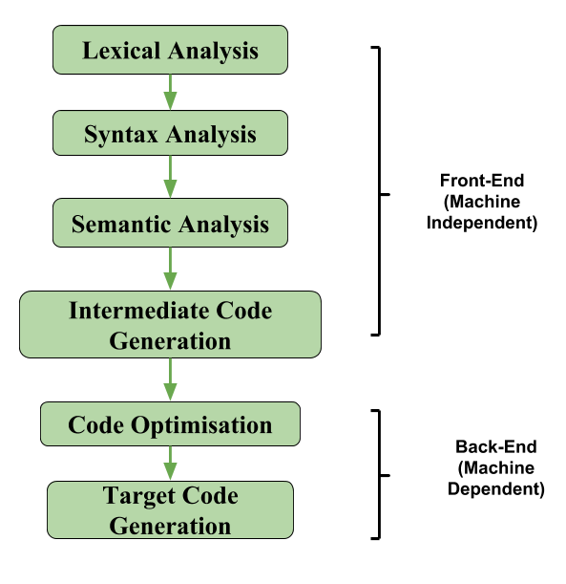
The back-end of a compiler
Definition (The back-end part of a compiler):
The back-end of a compiler takes the optimized and transformed code generated by the middle-end and translates it into machine code that can be executed.
It involves tasks, such as:
Instruction selection/ordering,
Register allocation,
and Code generation.

Slide 4
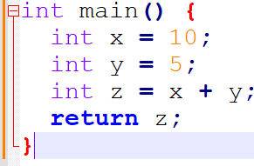
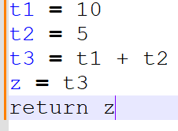
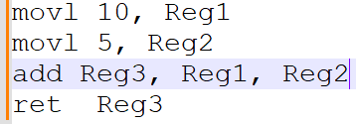
Source code (C)
Front-end
Lexical Analysis Syntax Analysis Semantic Analysis
After front-end, intermediate code (Three-address) and optimizations
Machine instructions after code generation and execution

Slide 5
Instruction Selection
Definition (Instruction Selection):
During instruction selection, the compiler chooses the specific machine code instructions (mov, add, jmp, etc) to use to implement each operation in the program.
During this step, it might perform some final transformations on the generated code to improve performance and reduce code size.
Typically, there might be multiple ways to choose and order machine code instructions. Some might be equivalent, others might allow to save memory/register space, etc.

Slide 6
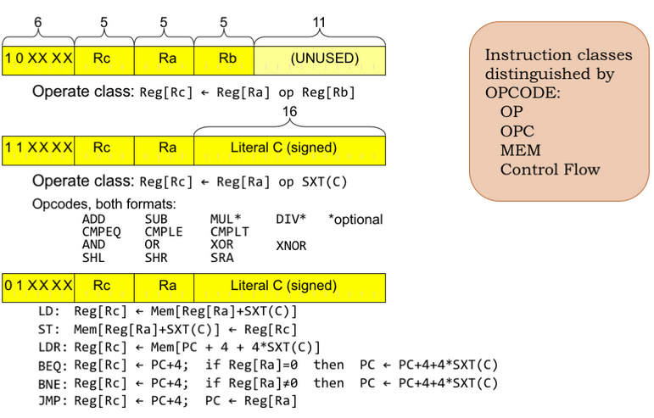
Instruction Selection
Definition (Instruction Selection):
During instruction selection, the compiler chooses the specific machine code instructions (mov, add, jmp, etc) to use to implement each operation in the program.
During this step, it might perform some final transformations on the generated code to improve performance and reduce code size.
Typically, there might be multiple ways to choose and order machine code instructions. Some might be equivalent, others might allow to save memory/register space, etc.

Slide 7
Instruction Ordering/Scheduling
Definition (Instruction Ordering/Scheduling):
The instruction ordering (or scheduling) phase is responsible for rearranging the order of instructions in the program to improve performance.
This typically involves reordering instructions to take advantage of the parallelism and pipelining features of modern processors (with many cores running in parallel, for instance).
The instruction scheduler takes into account the dependencies between instructions and the specific features of the processor.
(Too advanced, out-of-scope).

Slide 8
Intuition for code generation
Consider the TAC code below,
t1 = a + b
t2 = t1 * c
Intuition: This TAC code could be easily mapped to a sequence of machine code instructions, as shown on the right.
https://natalieagus.github.io/50002/notes/instructionset#opcode
Machine Code?
LOAD R1, a
LOAD R2, b
ADD R1, R1, R2
STORE t1, R1
LOAD R3, t1
LOAD R4, c
MUL R3, R3, R4
STORE t2, R3

Slide 9
Breakdown of the Machine Code Translation
This final translation is typically broken down in a few steps.
Basic block identification: The compiler identifies the basic blocks in the TAC code, i.e. sequences of instructions that are always executed together and can be used as units for generating machine code.
Instruction selection: For each operation in the TAC, the compiler selects an appropriate instruction or sequence of instructions in the machine assembly language. The choice may depend on the available instruction set, addressing modes, and architectural constraints.
For simplicity, we will stick to an instruction set similar to the one you used in 50.002 Computation Structures! (https://natalieagus.github.io/50002/notes/instructionset)

Slide 10
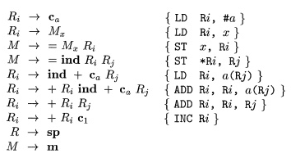
Instruction Selection (Simple Version?)
In our simpler version: the instruction selection, as a mapping could be easily done, by using a Syntax-Directed Translation (another one!) on our three-address code CFG!

Slide 11
Instruction Selection (Hard Version?)
Advanced compilers, however, might often rely on more advanced techniques, like tree matching and dynamic programming.
Tree pattern matching involves representing TAC operations as trees and searching for matching patterns in a database of target machine instructions.
Other techniques, like optimal code generation using dynamic programming, find the optimal sequence of target instructions by considering all possible combinations and selecting the one with the lowest cost (memory, computation, time, etc.).
This last set of techniques is much more advanced and out-of-scope.

Slide 12
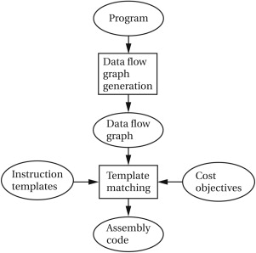
Instruction Selection (mapping vs. advanced)
Note: These advanced techniques will often require solving optimization problems on graphs that are NP-Hard!
Definitely out-of-scope! (It would require an advanced course on Graph Theory to simply explain some of them!)

Slide 13
Instruction Selection (Harder Version?)
In addition, advanced compilers, might also use several intermediate representations in a row, instead of jumping straight from TAC to machine code.
Abstract Syntax Tree Representation
High-level Intermediate Representation (e.g. TAC)
Lower-level Intermediate Representations (e.g. SSA, RTL, VM, etc.)
Assembly code (our target code)
Machine code in binary (but technically more 50.002 than 50.051)

Slide 14
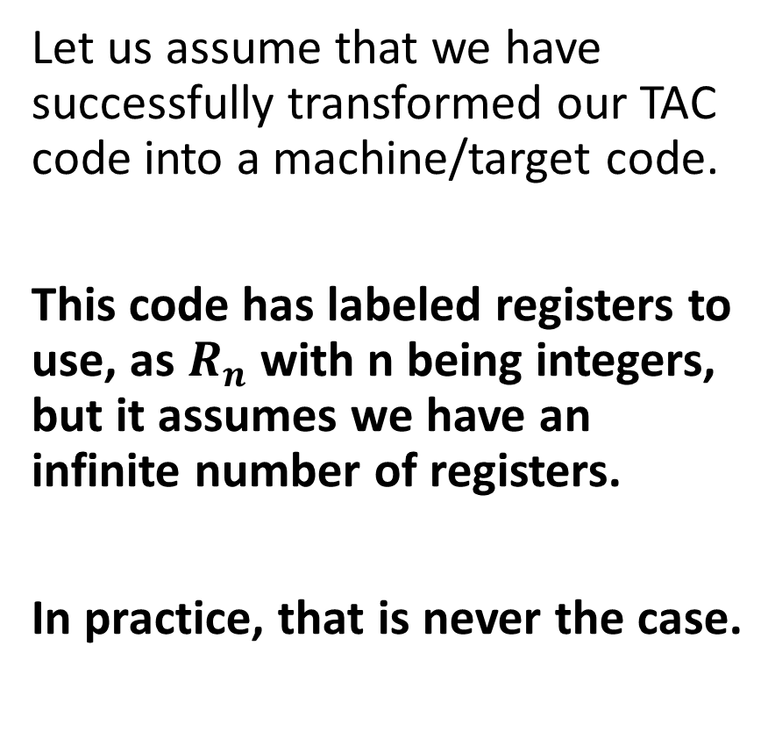
Intuition for register allocation
Let us assume that we have successfully transformed our TAC code into a machine/target code.
This code has labeled registers to use, as $R_{n}$with n being integers, but it assumes we have an infinite number of registers.
In practice, that is never the case.
Machine Code?
LOAD R1, a
LOAD R2, b
ADD R1, R1, R2
STORE t1, R1
LOAD R3, t1
LOAD R4, c
MUL R3, R3, R4
STORE t2, R3

Slide 15
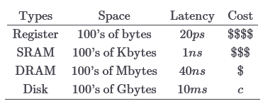
Memory Hierarchy
Definition (Memory Hierarchy):
In practice, not all memory locations are equal, there is a memory hierarchy.
Registers: very few of them, fast and expensive.
SRAM: few of them, slightly slower, but still quite fast.
DRAM: more of them, slower.
Disk: Potentially unlimited space, but very slow.
Need a refresher from 50.002?
https://natalieagus.github.io/50002/notes/memoryhierarchy
Cheap/Plenty
Computational Speed

Slide 16
A resource allocation problem
How would you decide which variables to prioritize and assign to registers, and which variables to keep in other memory locations?
Objective: Position objects in memory in a way that takes maximum advantage of the memory hierarchy and speeds up computation.
Additional challenge: Do so without hints from the programmer.
Why it is important: A good register allocator can generate code orders of magnitude better than a bad register allocator.

Slide 17
Possible algorithms to investigate
The register allocation problem is not an easy one to solve! (NP-hard).
We propose to briefly explore three algorithms for register allocation:
Naïve (“no”) register allocation.
Linear scan register allocation.
Graph-coloring register allocation.
Their implementations might require tools from graph theory (especially the last one), and are therefore out-of-scope.

Slide 18
A starting idea
Starting idea: Store every value in main memory, loading values only when they are needed.
To generate a code that performs a computation:
Generate load instructions to pull the values from main memory into registers.
Only use three registers at any given time, because that is the maximal number of operands in TAC/assembly instruction anyway.
Generate code to perform the computation on these registers.
Generate store instructions to store the result back into main memory.

Slide 19
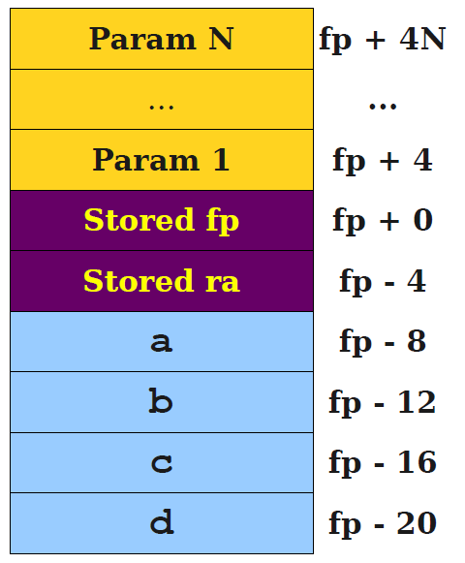
A starting idea
Our TAC code (for a function of some sort)
a = b + c;
d = a;
c = a + d;
lw $t0, -12(fp)
lw $t1, -16(fp)
add $t2, $t0, $t1
sw $t2, -8(fp)
lw $t0, -8(fp)
sw $t0, -20(fp)
lw $t0, -8(fp)
lw $t1, -20(fp)
add $t2, $t0, $t1
sw $t2, -16(fp)

Slide 20
Analysis of this first naïve register allocation
Disadvantage: Gross inefficiency.
Issues unnecessary loads and stores by the dozen.
Wastes space on values that could be stored purely in registers.
Easily an order of magnitude or two slower than necessary.
Unacceptable in any production compiler.
Advantage: Simplicity.
Can translate each piece of IR directly to assembly as we go.
Never need to worry about running out of registers.
Never need to worry about function calls or special-purpose registers.
Good if you just needed to get a prototype compiler up and running.

Slide 21
A slightly better approach
New idea: In practice, we have very few registers, but definitely more than just three! Try to hold as many variables in registers as possible.
Hopefully, this will reduce memory reads/writes and reduces total memory usage.
However, we will need to address these questions:
Which registers do we put variables in?
How do we recognize that we have run out of registers?
What do we do when we run out of registers?

Slide 22
A slightly better approach
Fact #1: At each program point, each register holds at most one live variable (otherwise, there is a memory conflict).
This means that we could assign several variables the same register, as long as no two of them ever will be read together.
The liveness analysis we used earlier in the IR optimization phase could therefore hold the key as to which variables need to be live (and therefore in a register somewhere) at any given point?
At any point of the program, liveness analysis lets us know when variables are live and for how long.

Slide 23
Live range and live interval
Definition (live range):
The live range for a variable is the set of program points at which that variable is live. This means that the variable NEEDS to be in a register at that time.
Definition (live interval):
The live interval for a variable is the smallest subrange of the IR code containing all a variable’s live ranges.
A property of the IR code, not the CFG.
Less precise than live ranges, but simpler to work with.
That consists of all the times where it would be nice to have the variable in a register.

Slide 24
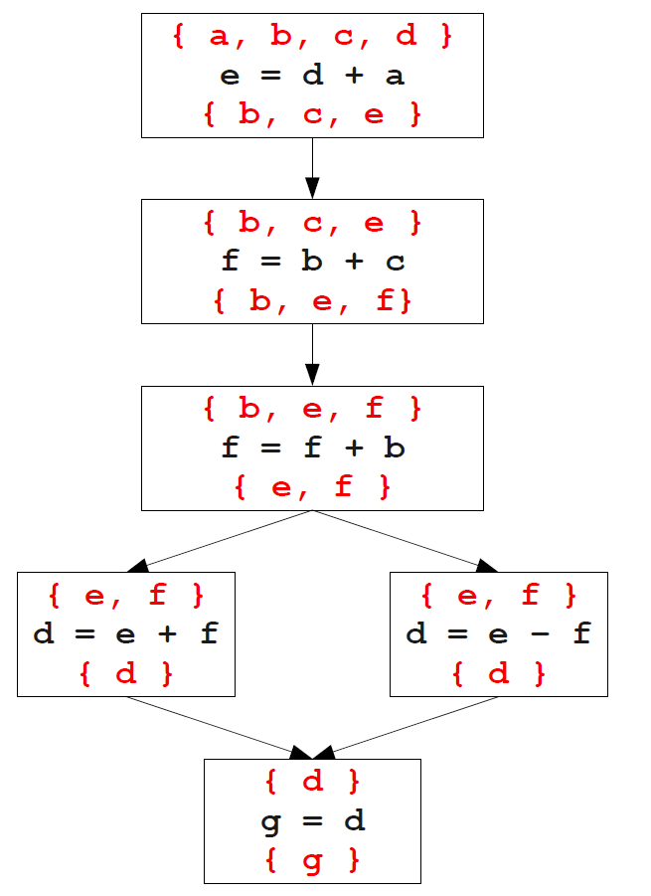
Live range and live intervals: demo
Consider the TAC code below.
L0:
e = d + a
f = b + c
f = f + b
if e goto L1
d = e + f
jump L2;
L1:
d = e - f
L2:
g = d
After control-flow and liveness analysis

Slide 25
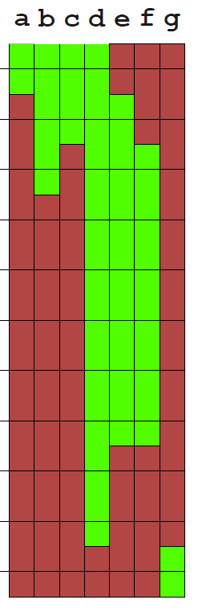
Live range and live intervals: demo
Consider the TAC code below.
L0:
e = d + a
f = b + c
f = f + b
if e goto L1
d = e + f
jump L2;
L1:
d = e - f
L2:
g = d
After control-flow and liveness analysis
Live intervals

Slide 26
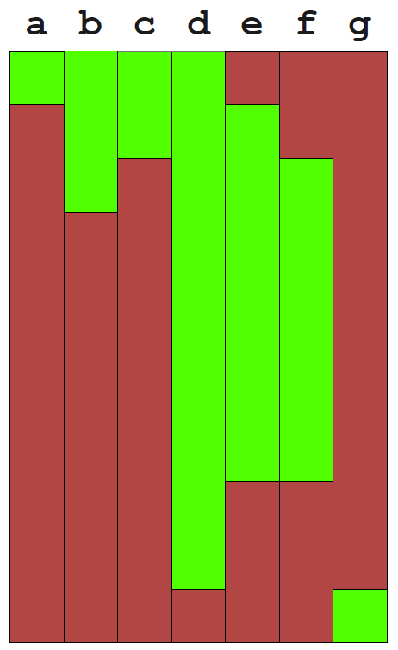
Using live ranges
Idea (continued): Given the live intervals for all the variables/IR registers in the TAC program, we can allocate registers using a simple greedy algorithm.
Track which registers are free.
When a live interval begins, give that variable a free register.
When a live interval ends, the register could be freed without consequences.

Slide 27
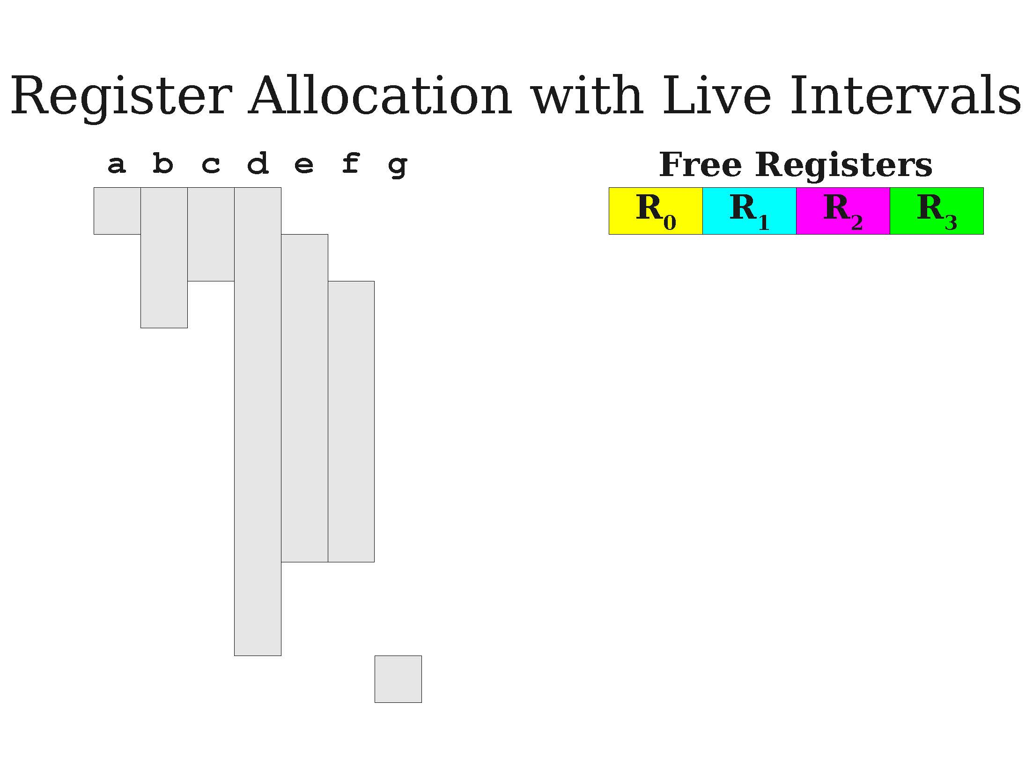
A first demo of greedy allocation

Slide 28
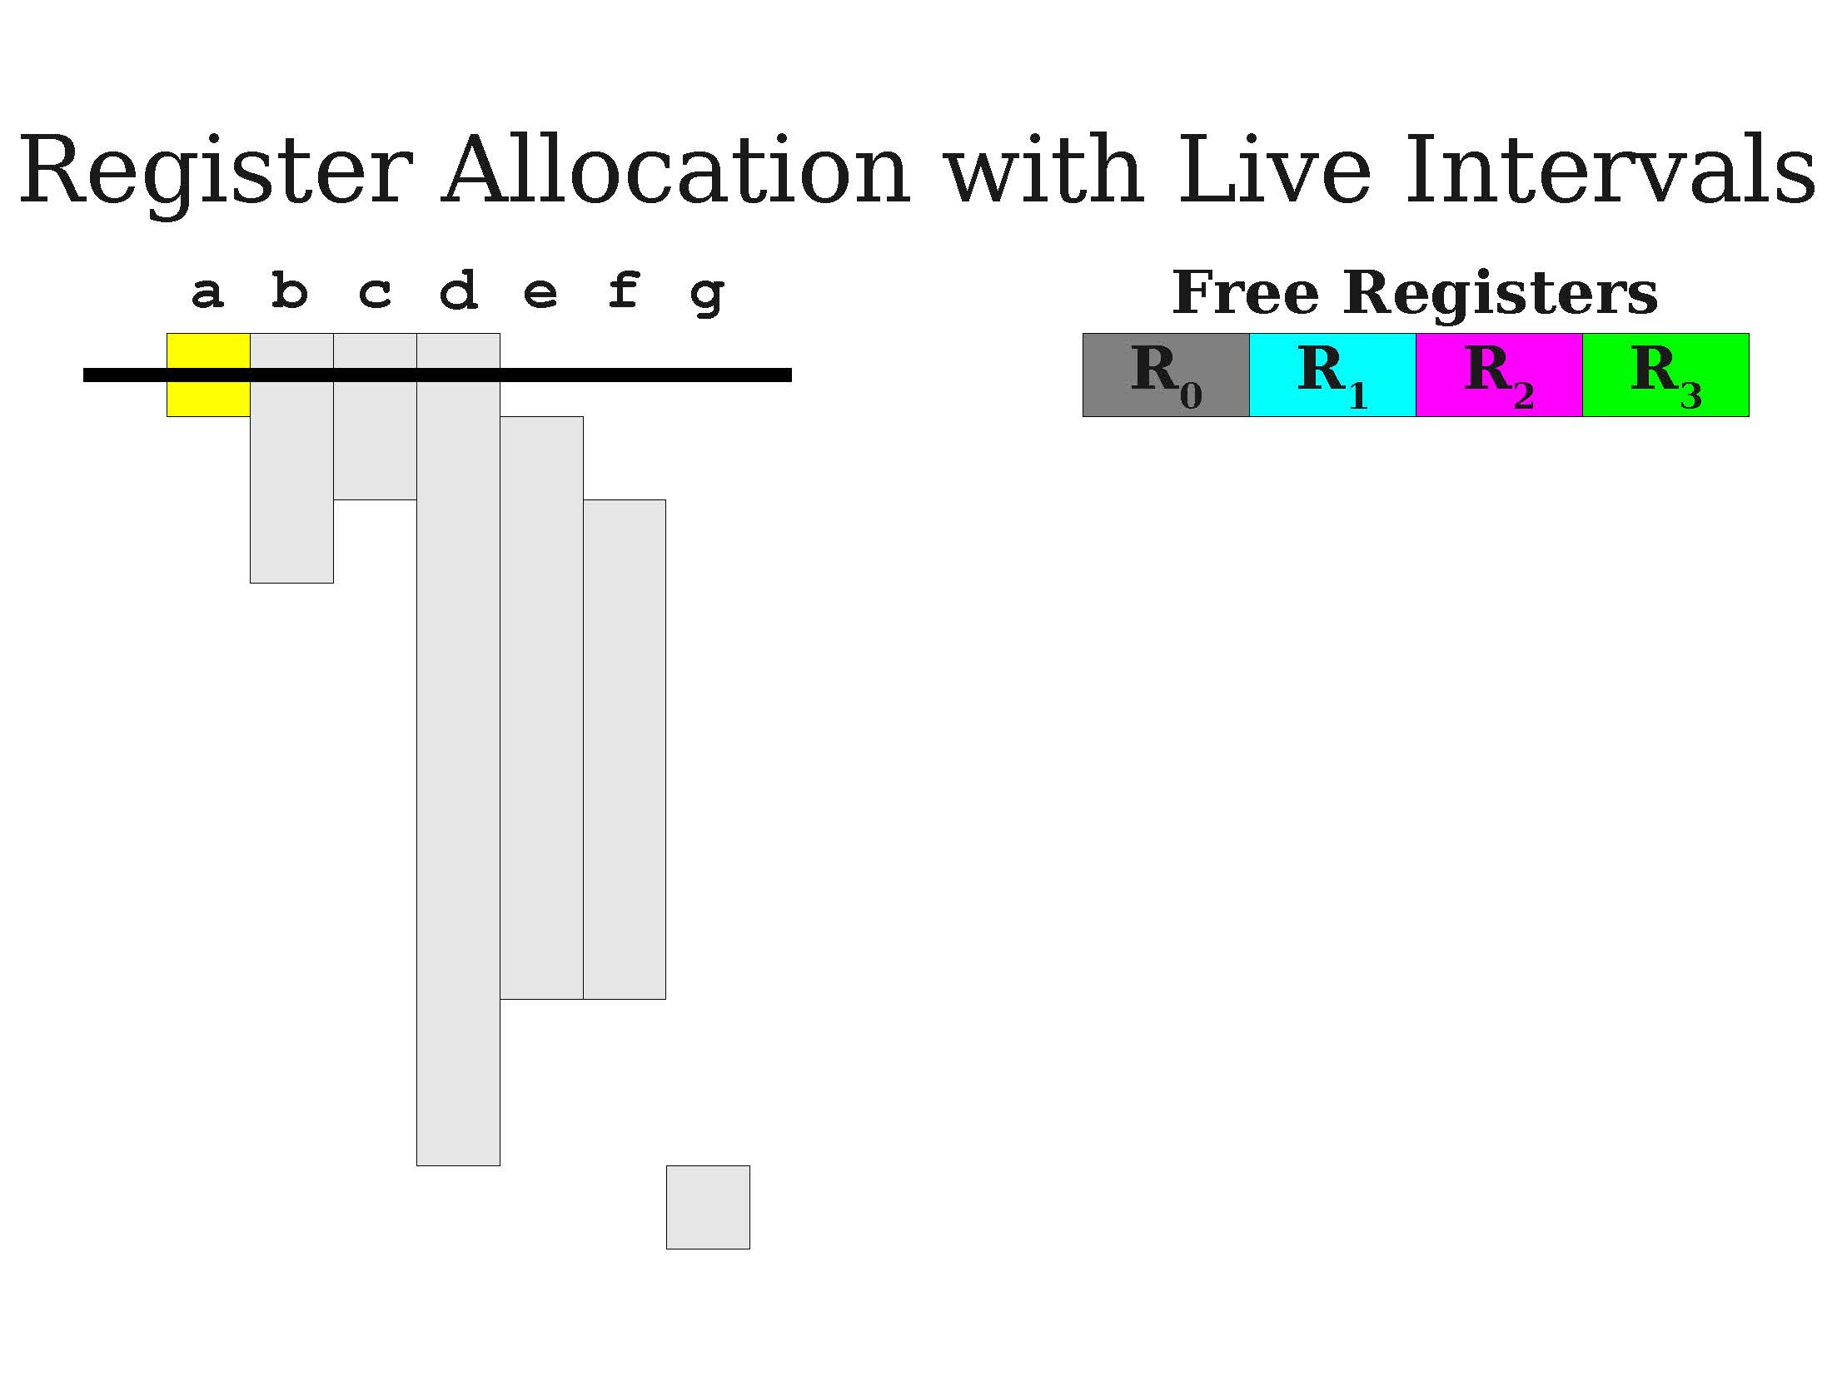
A first demo of greedy allocation

Slide 29
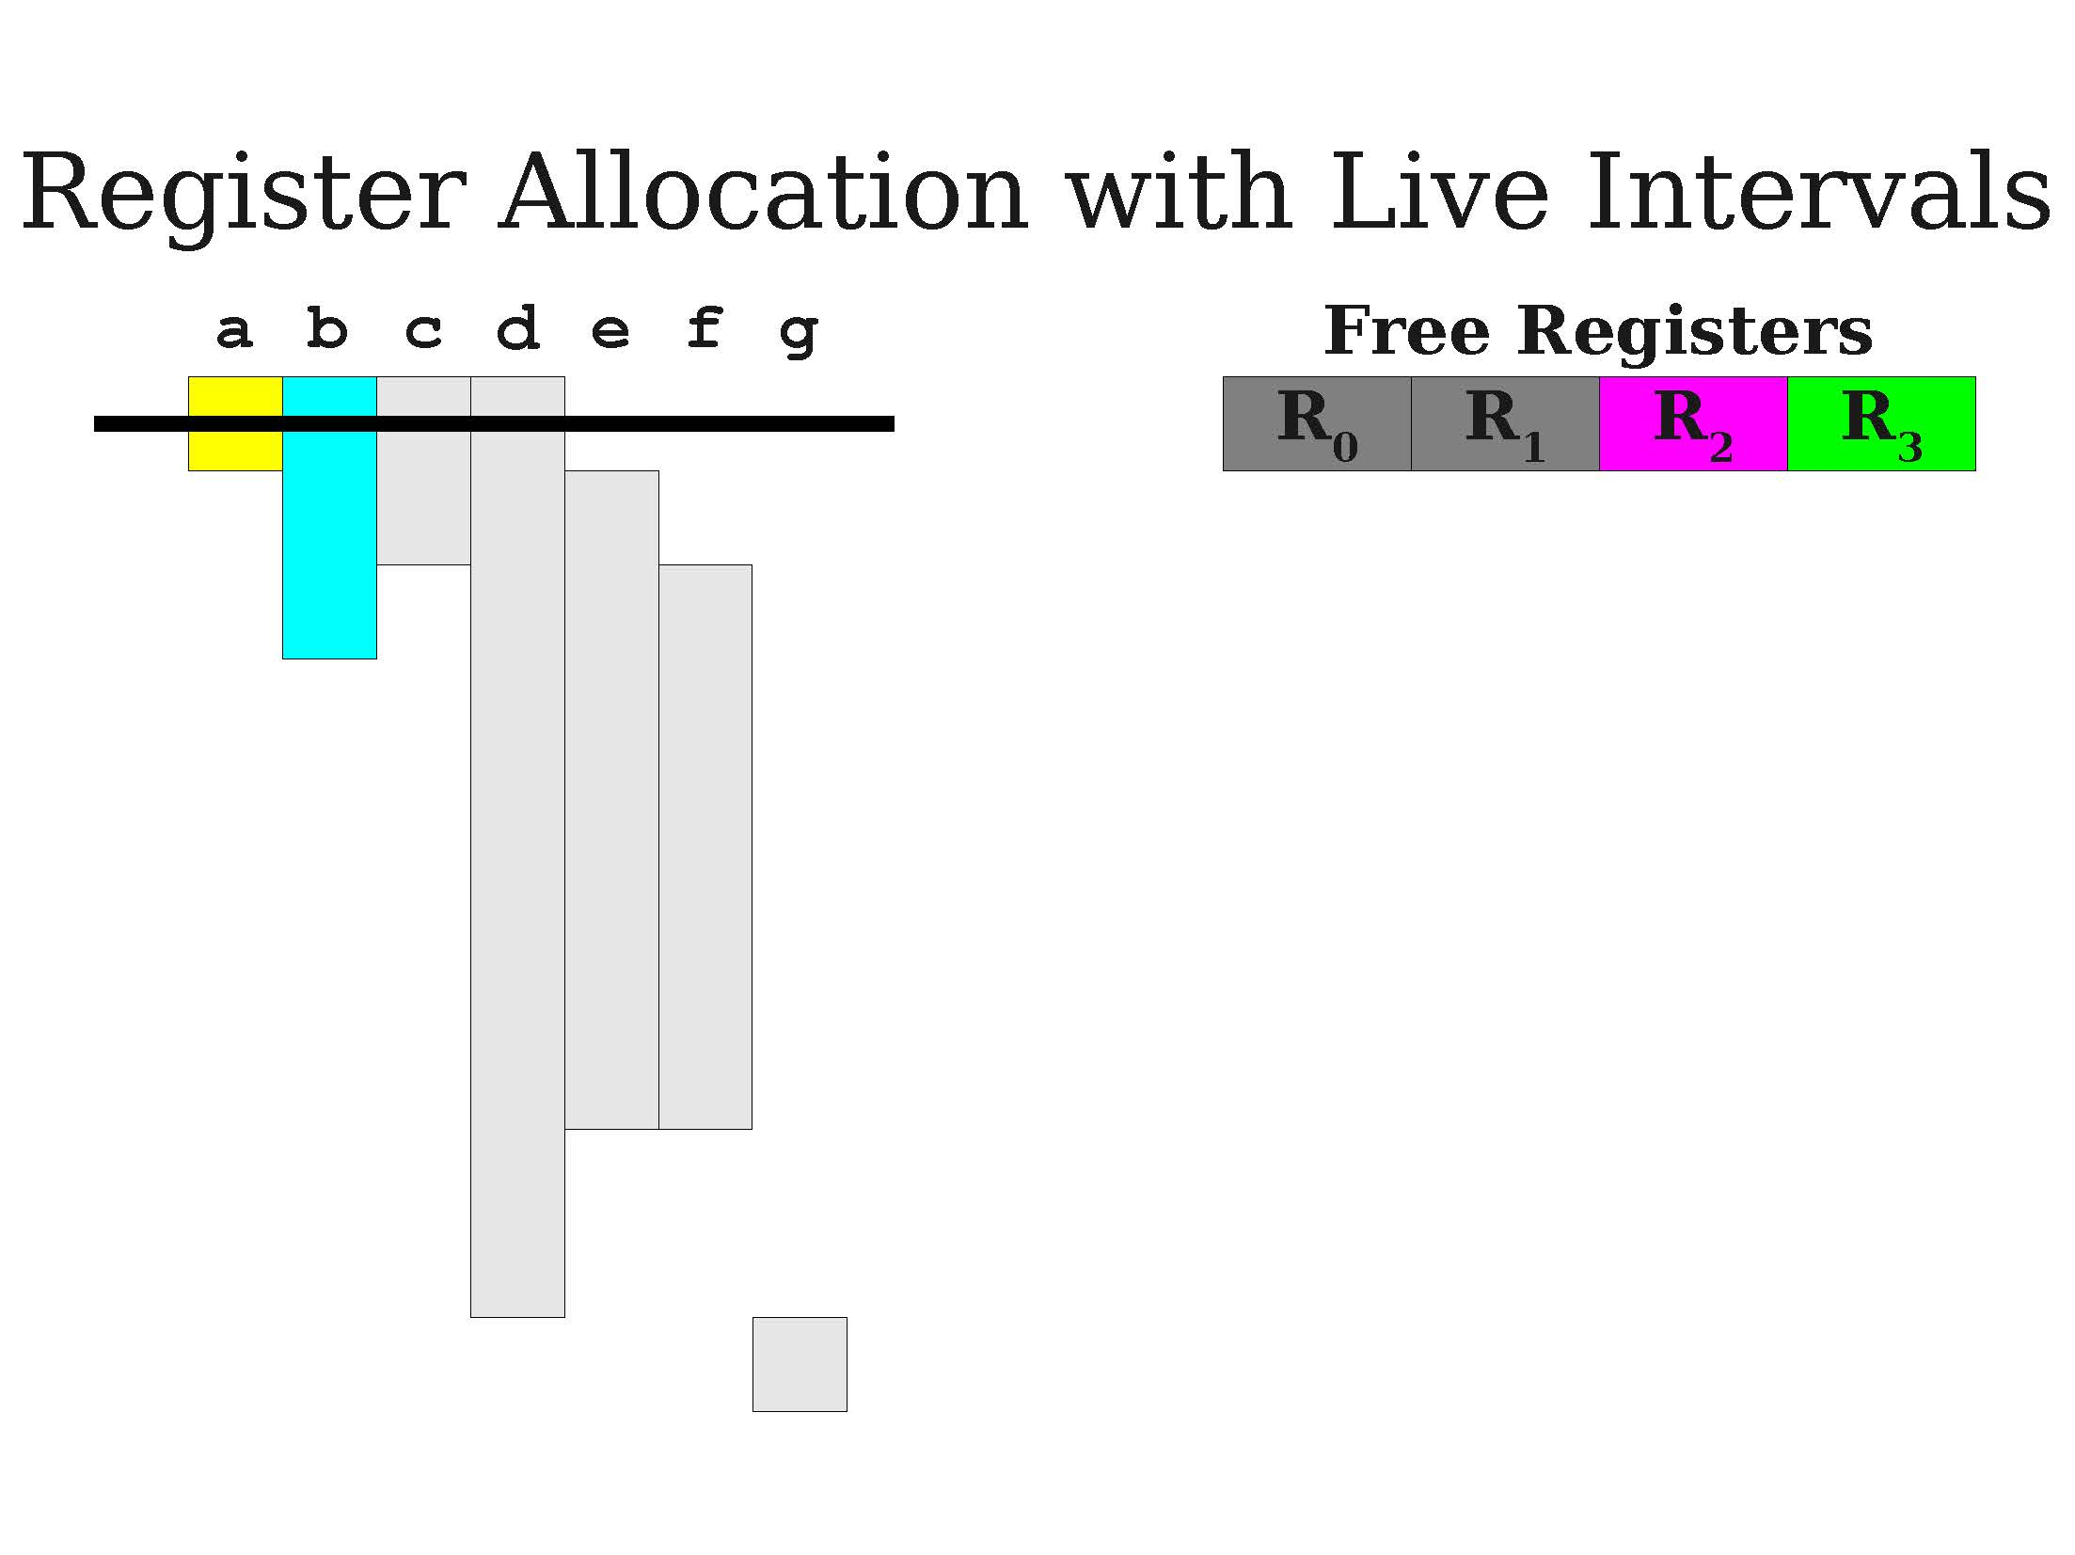
A first demo of greedy allocation

Slide 30
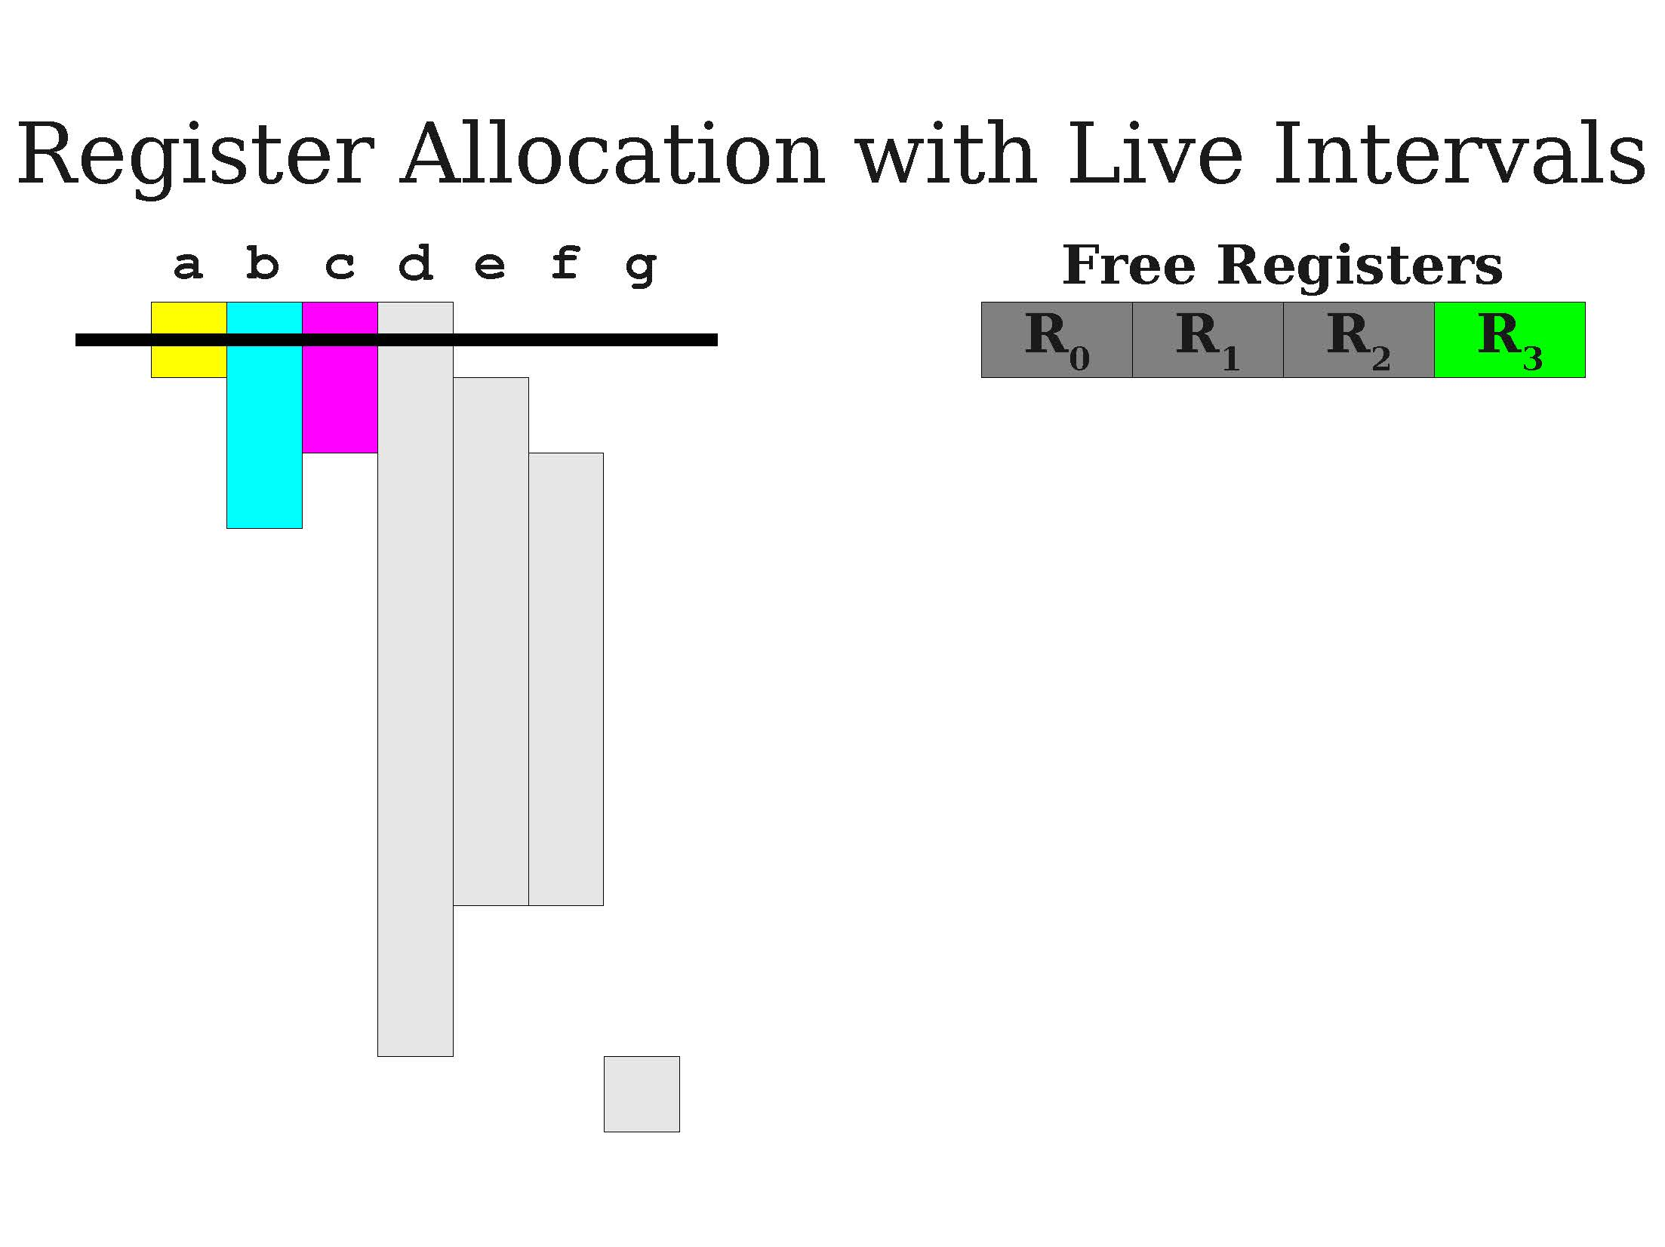
A first demo of greedy allocation

Slide 31
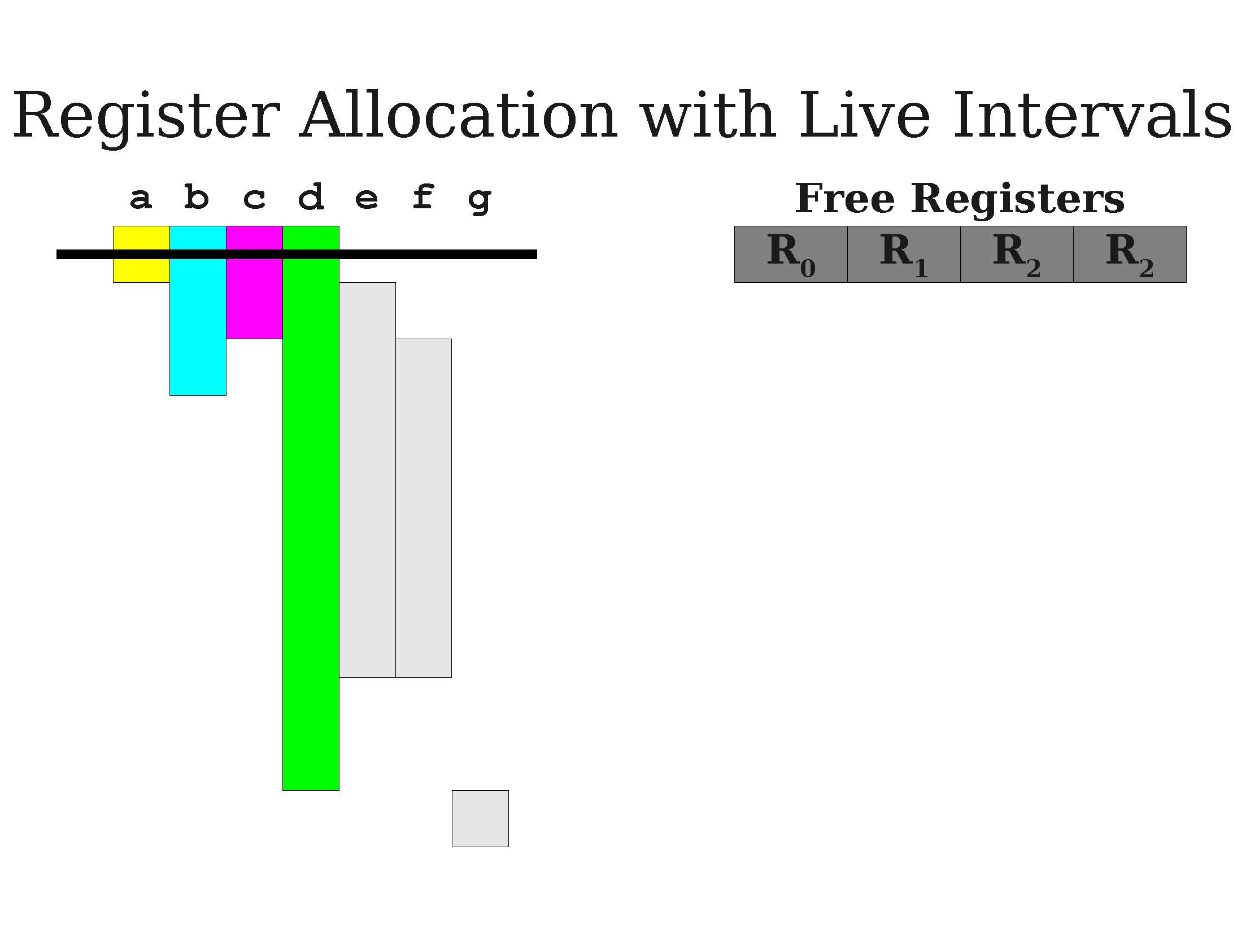
A first demo of greedy allocation

Slide 32
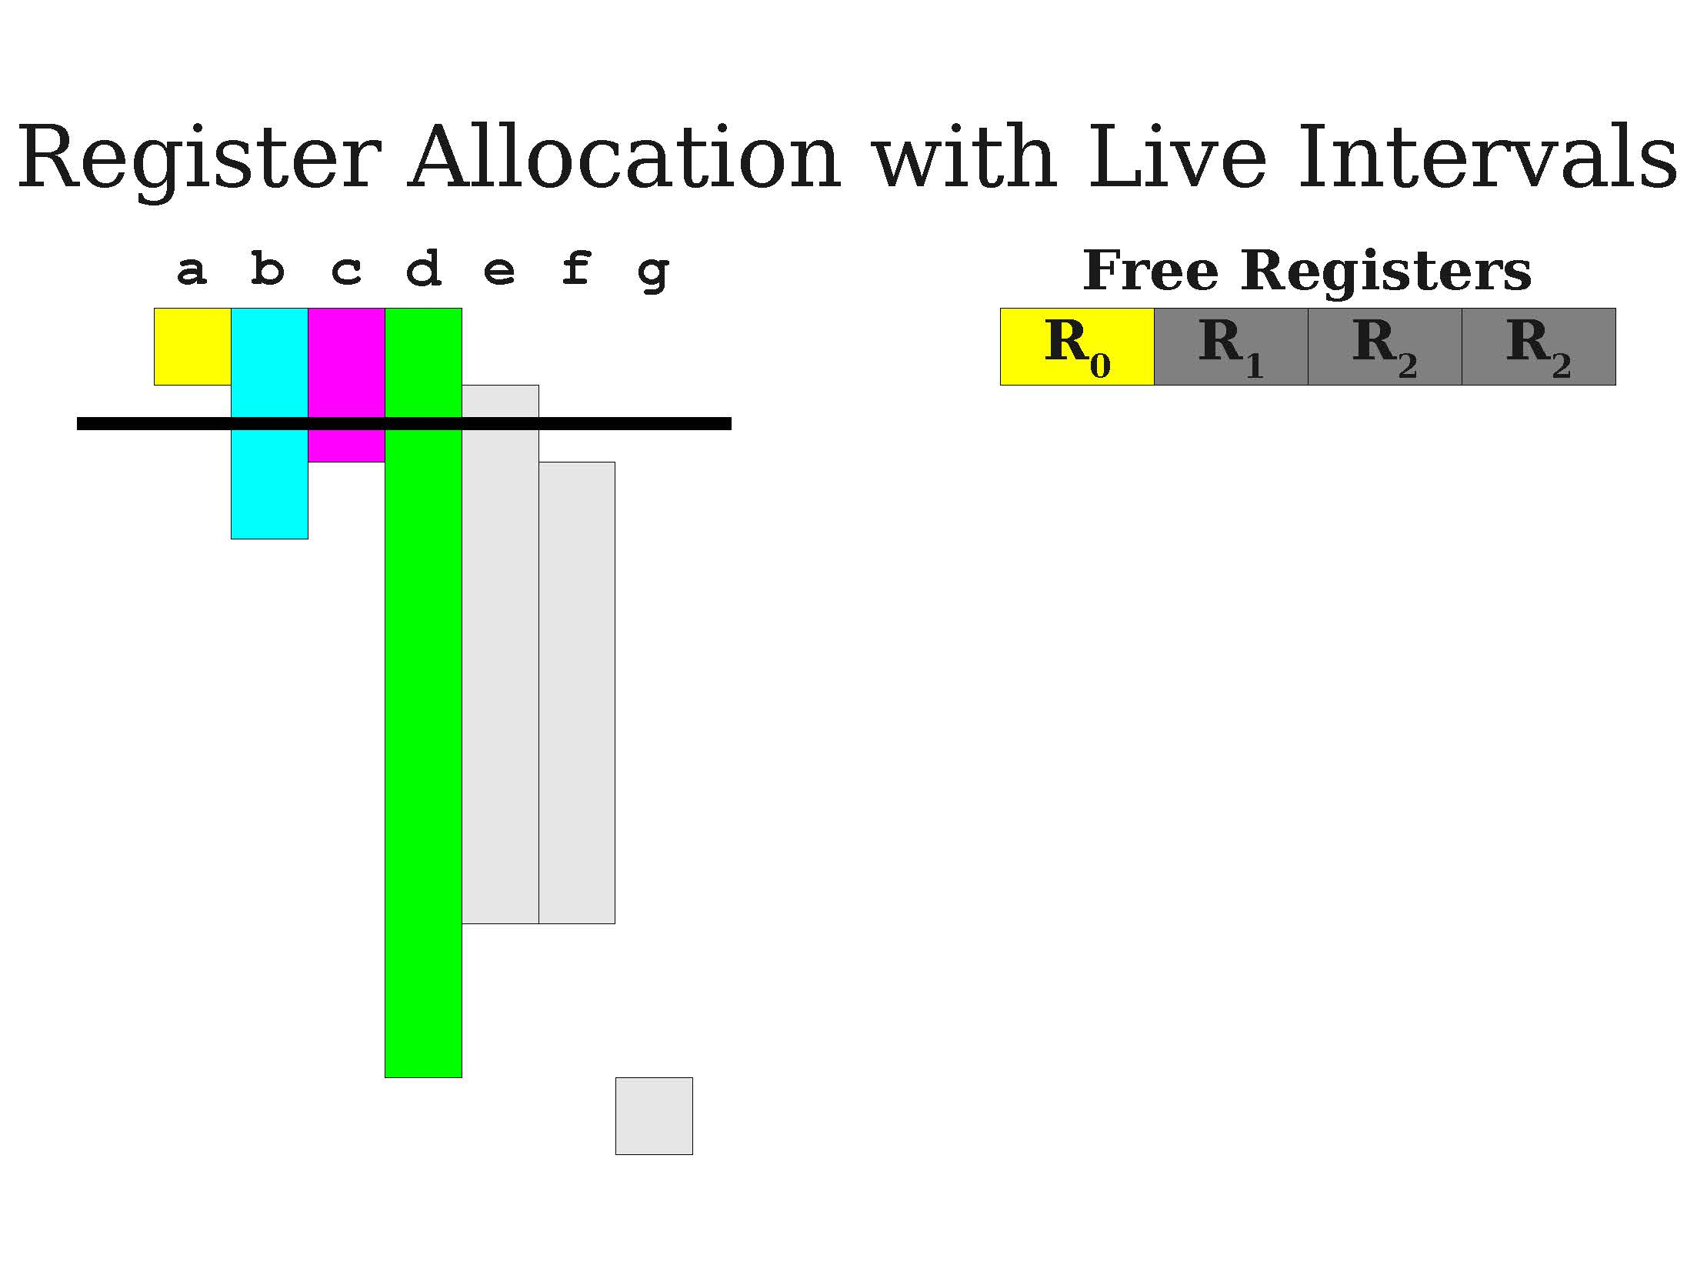
A first demo of greedy allocation

Slide 33
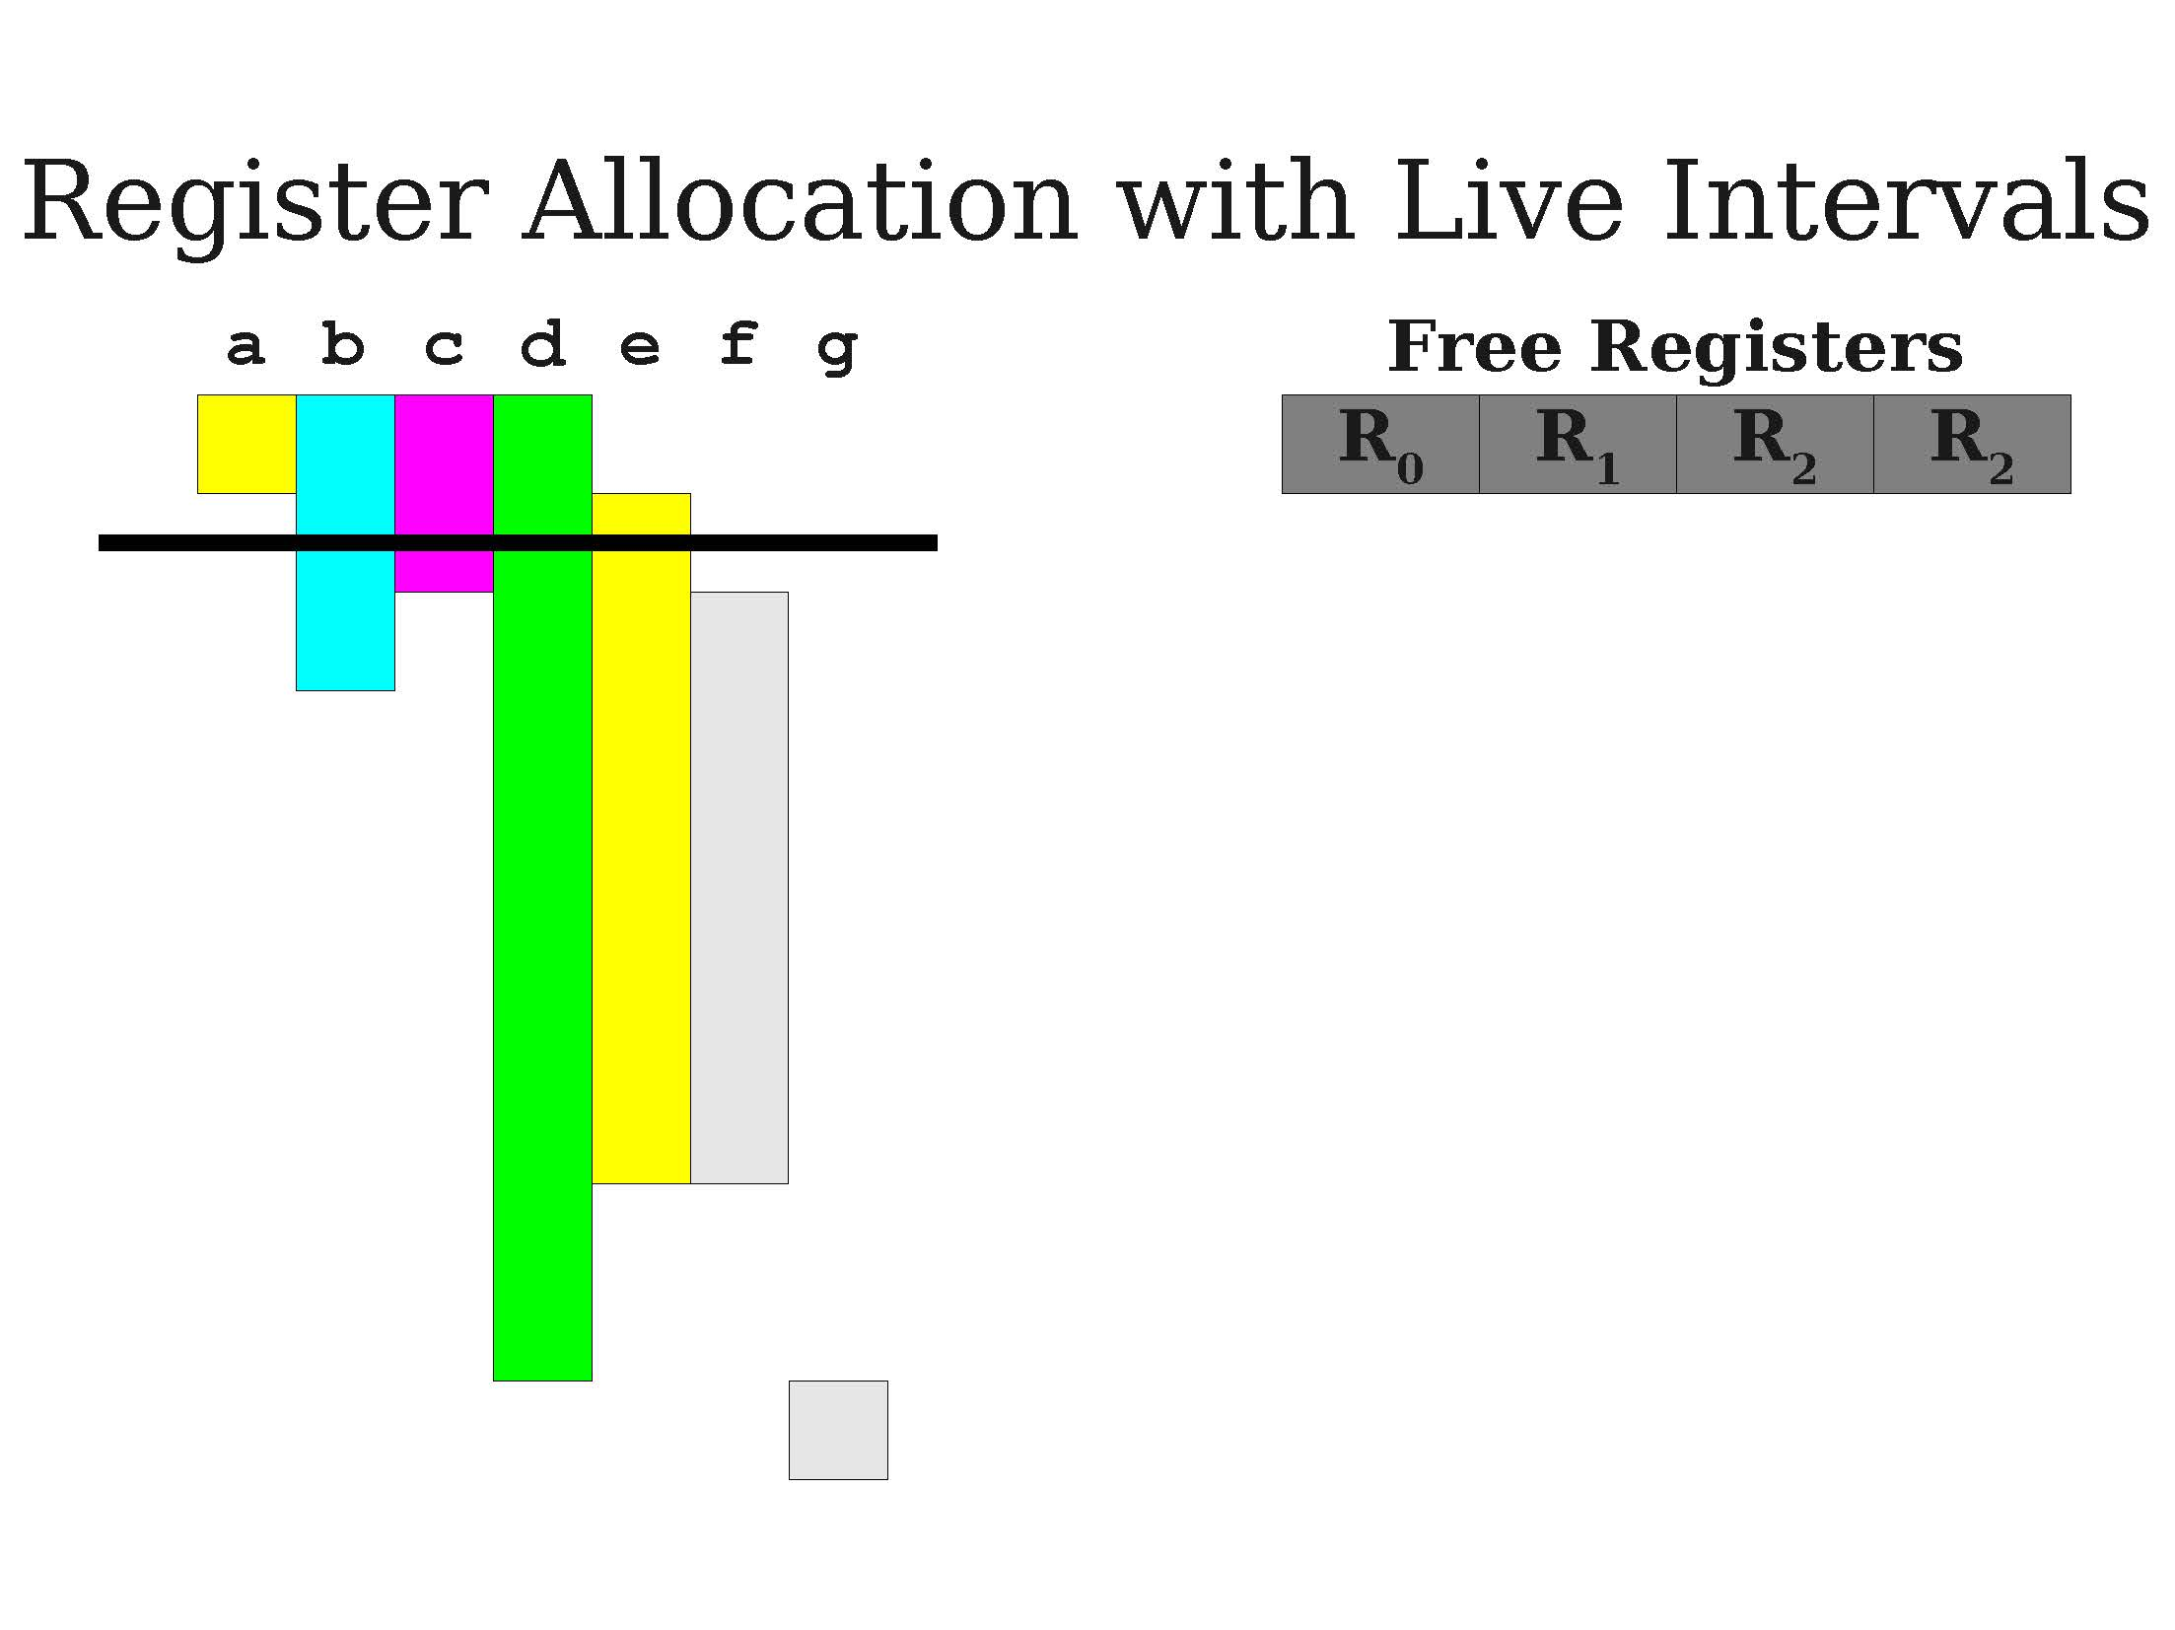
A first demo of greedy allocation

Slide 34
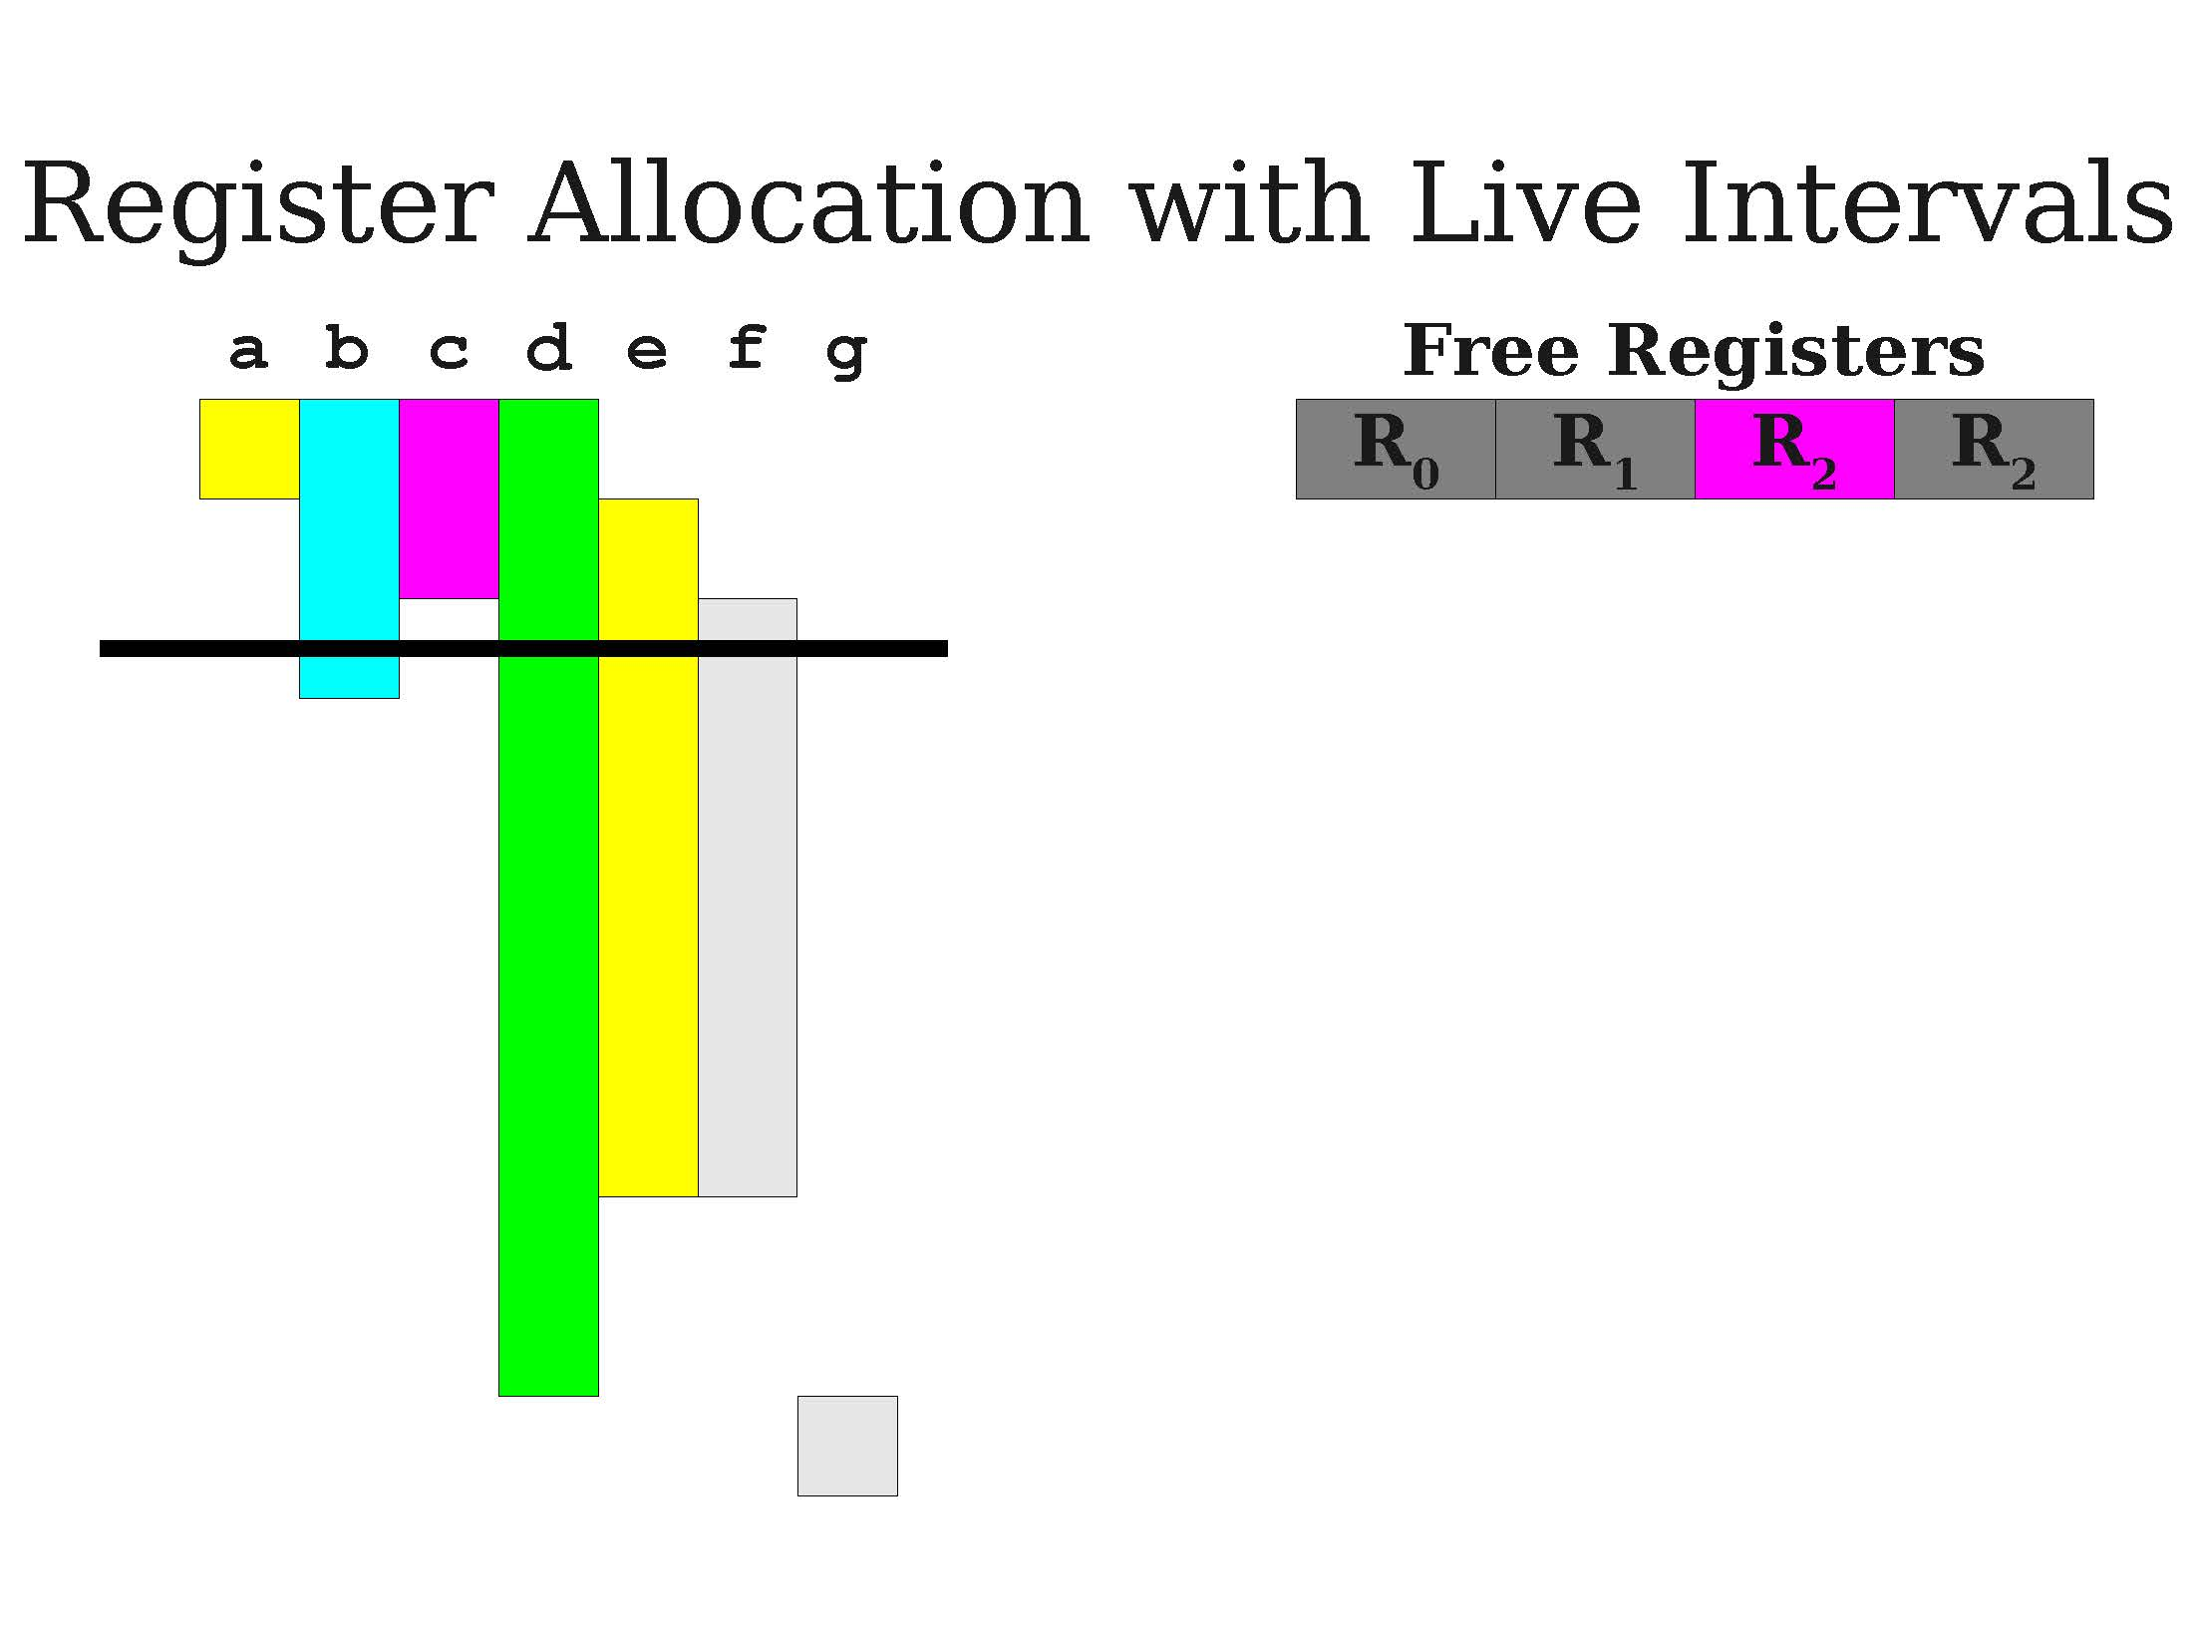

Slide 35
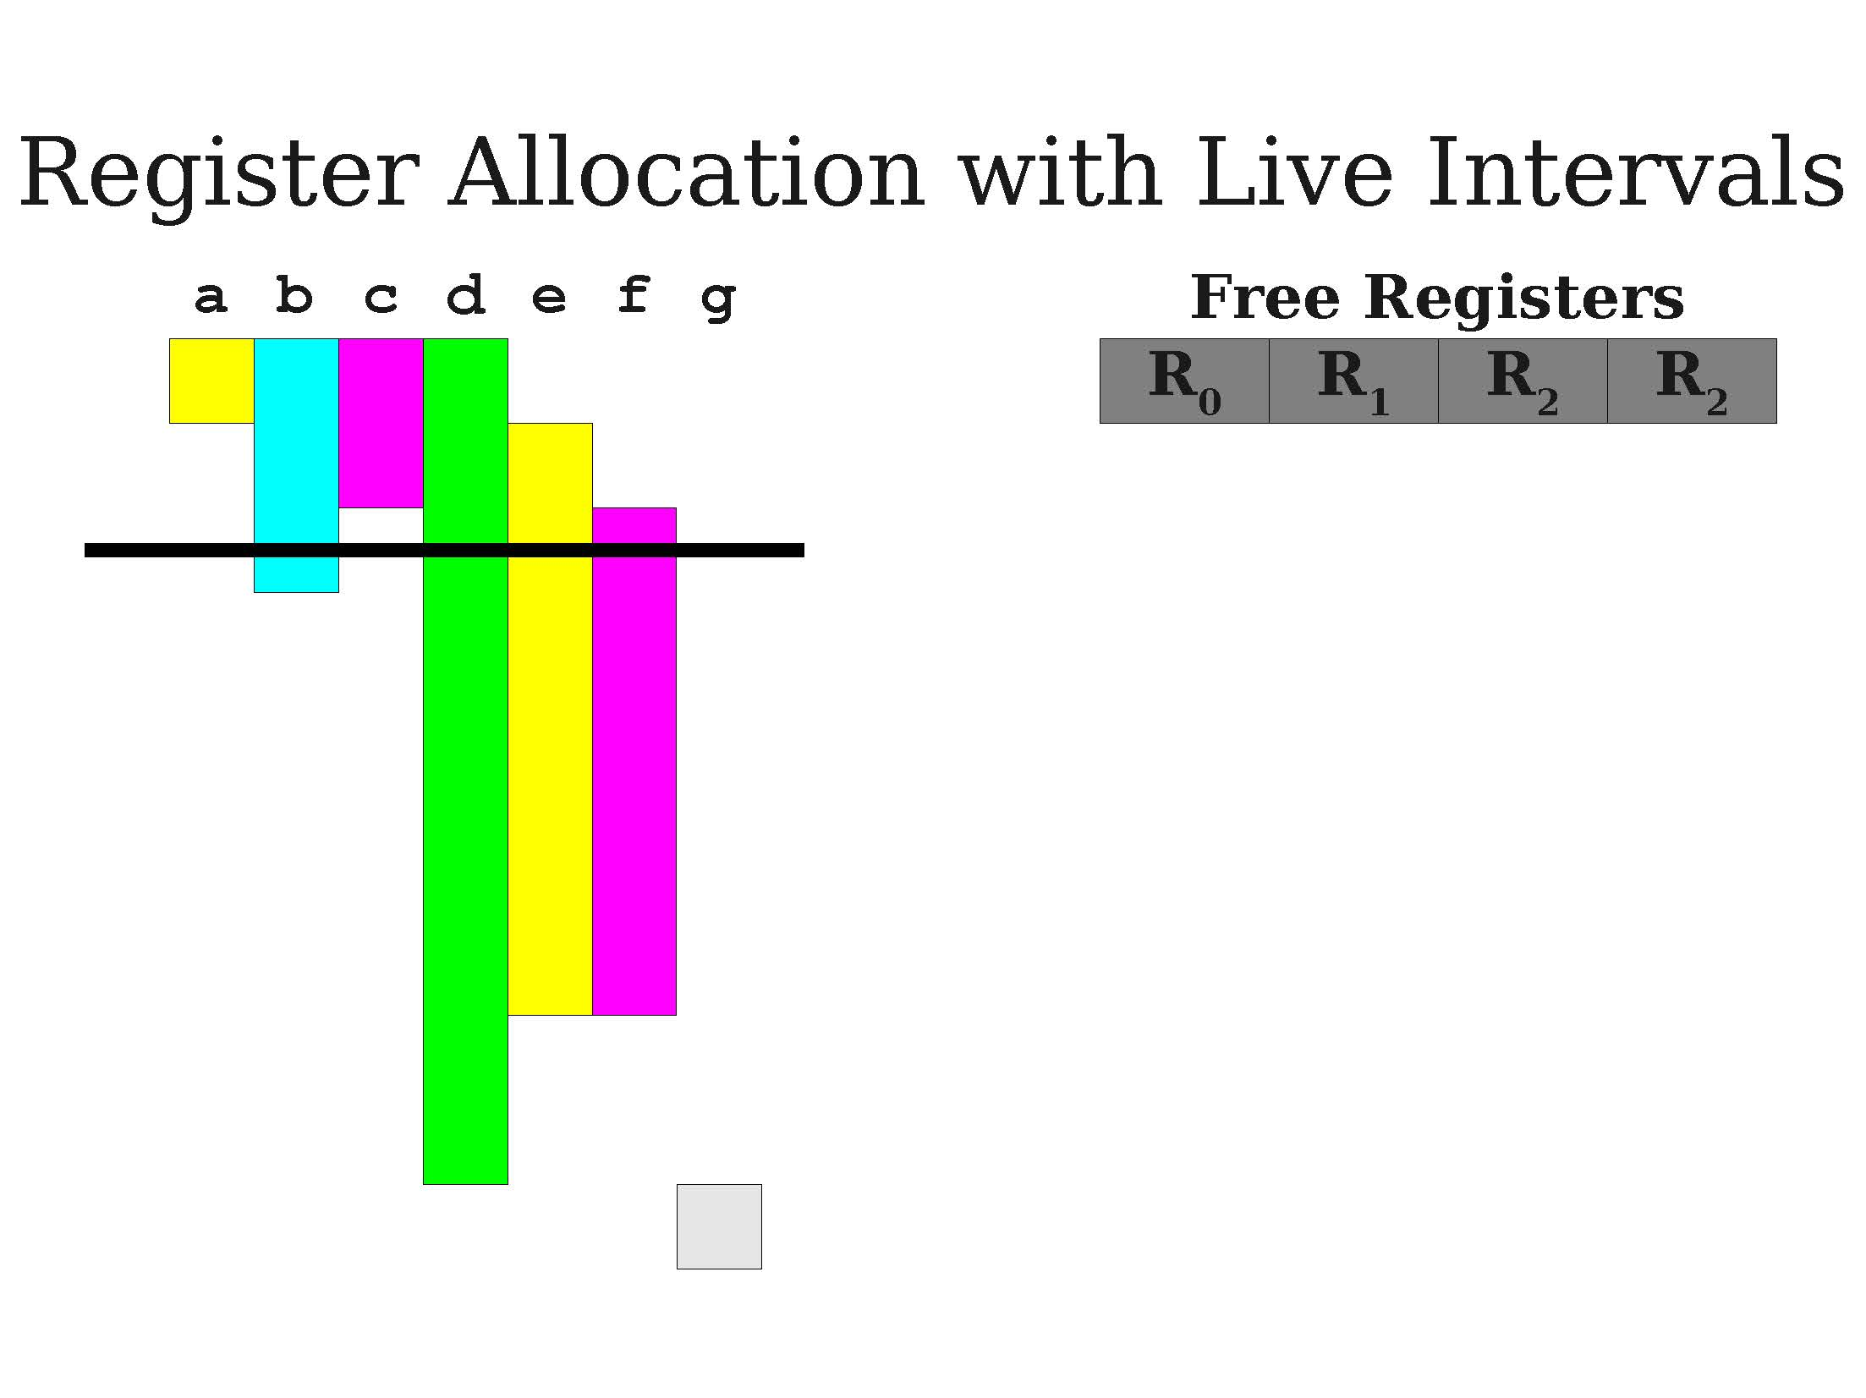
A first demo of greedy allocation

Slide 36
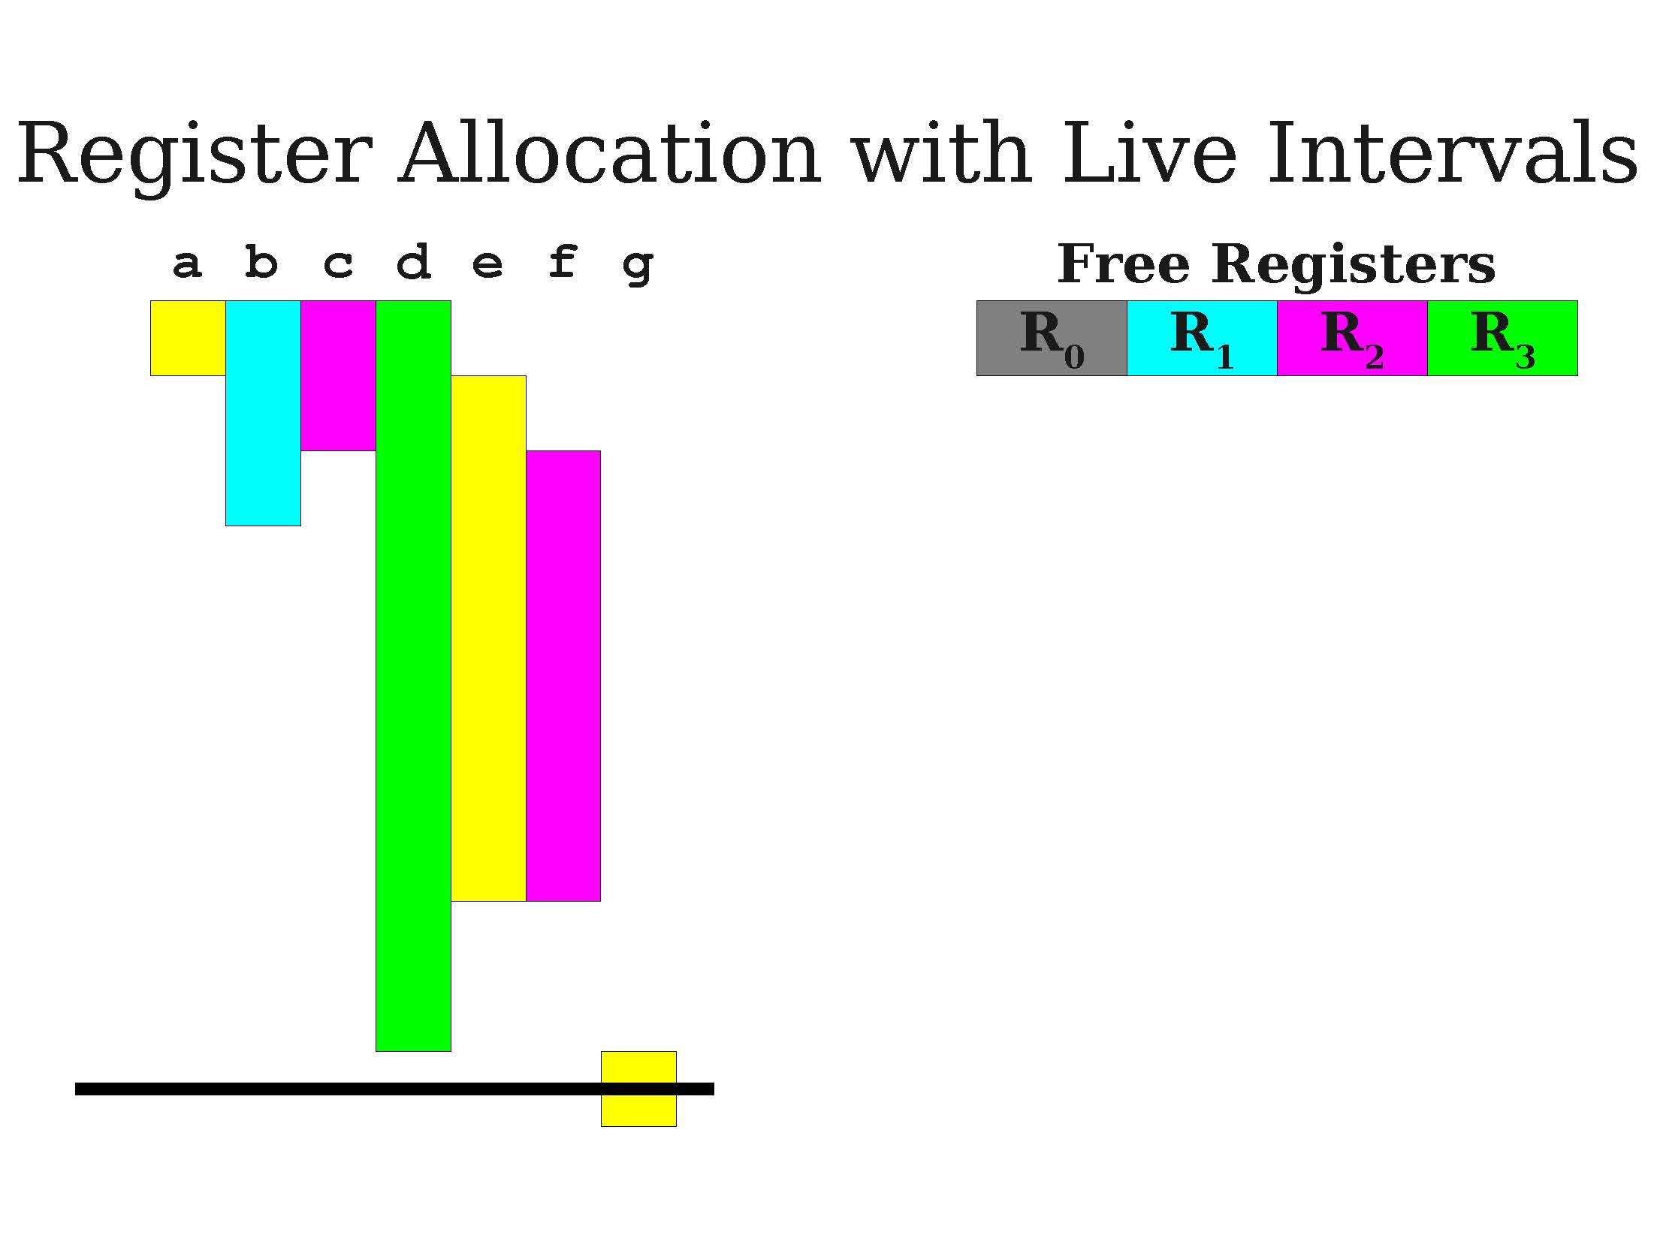
A first demo of greedy allocation

Slide 37
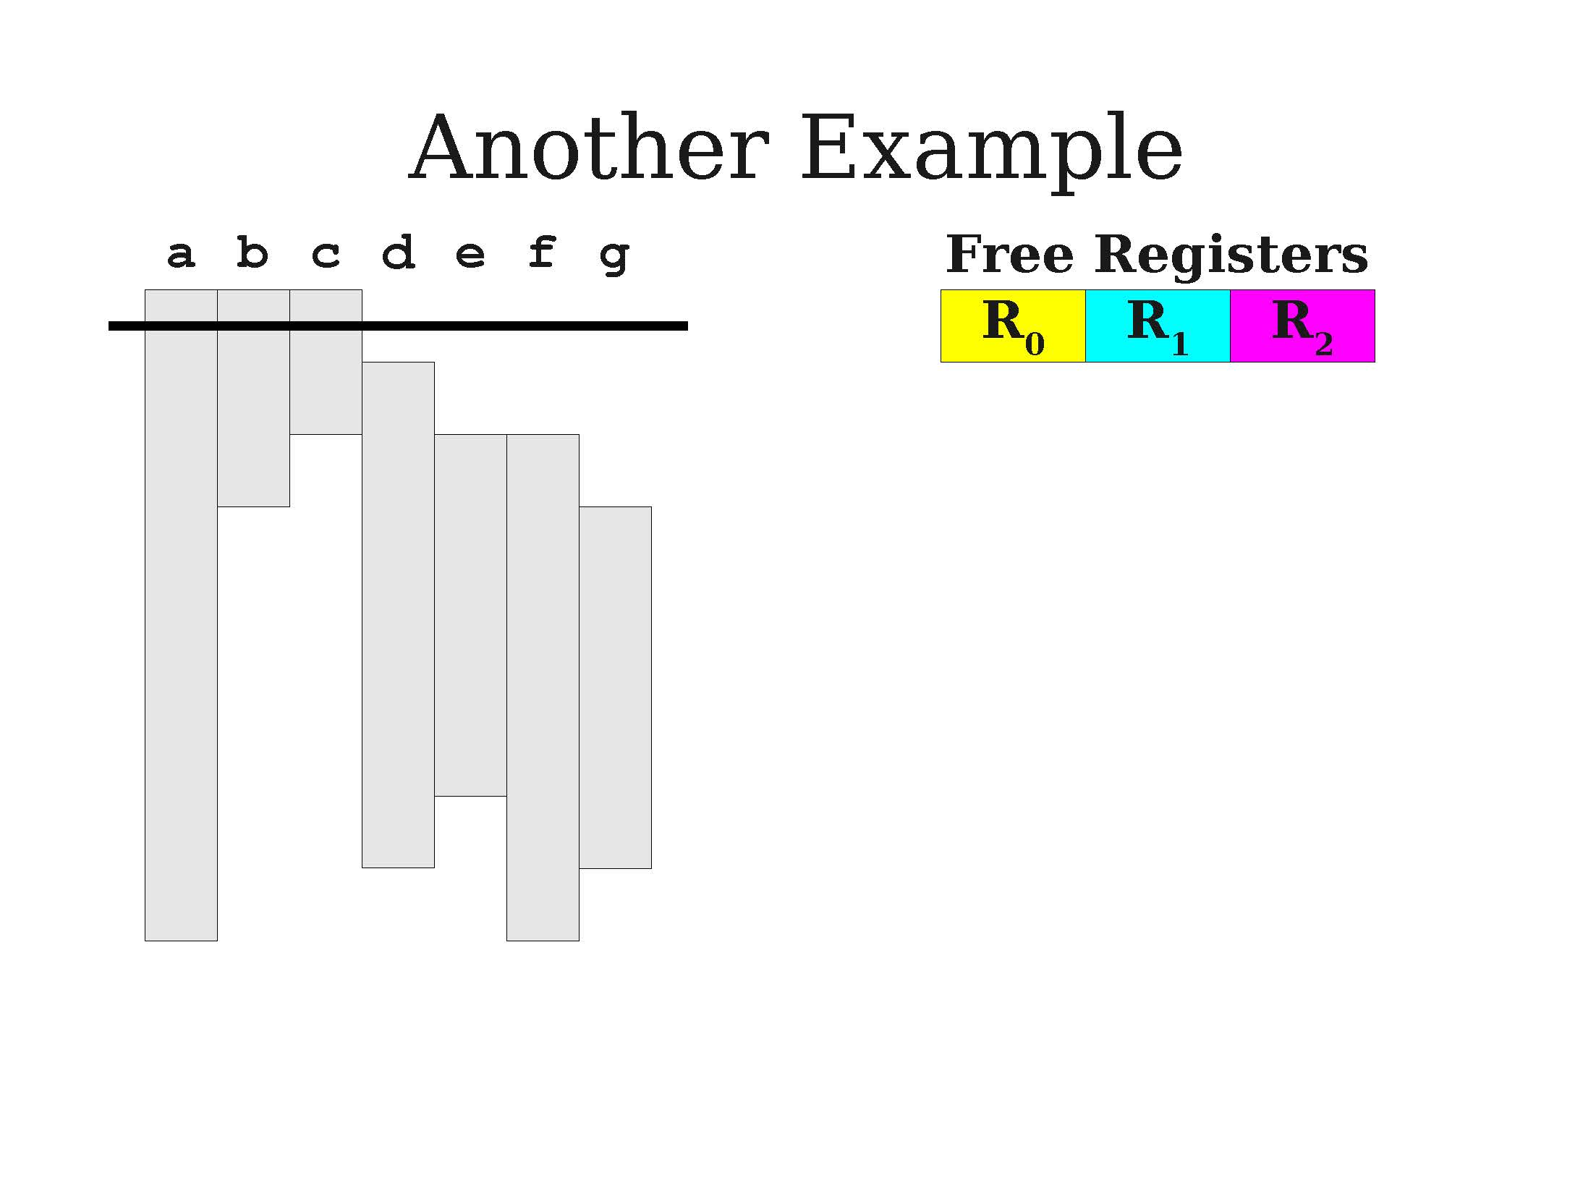
A second demo of greedy allocation

Slide 38
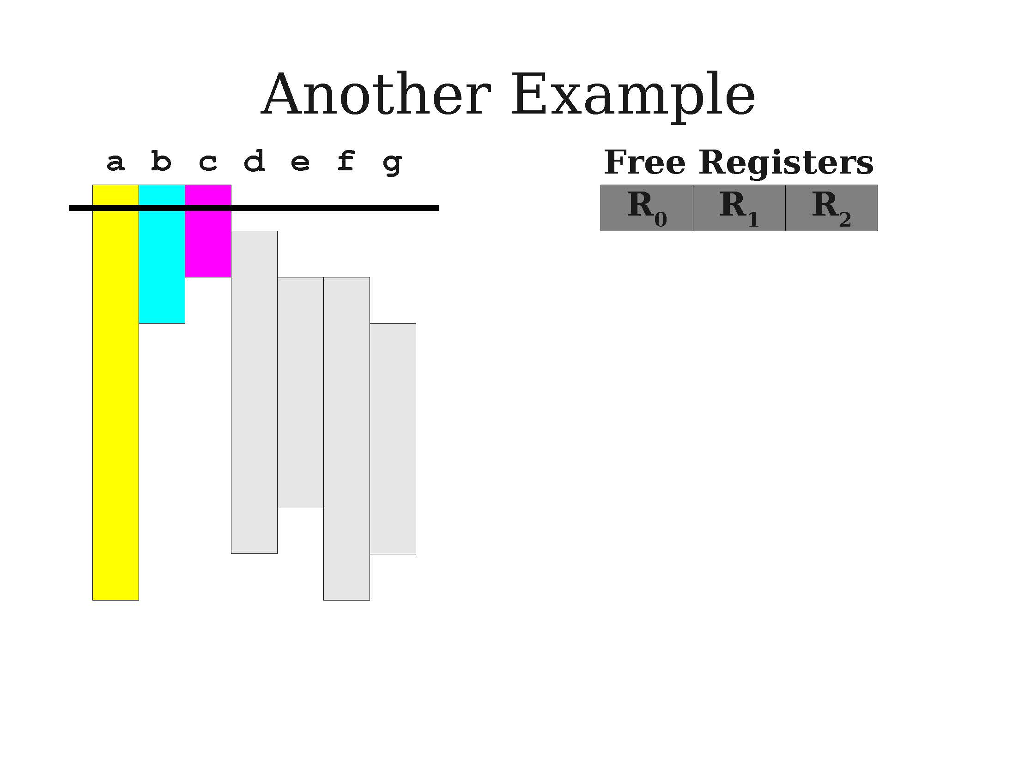
A second demo of greedy allocation

Slide 39
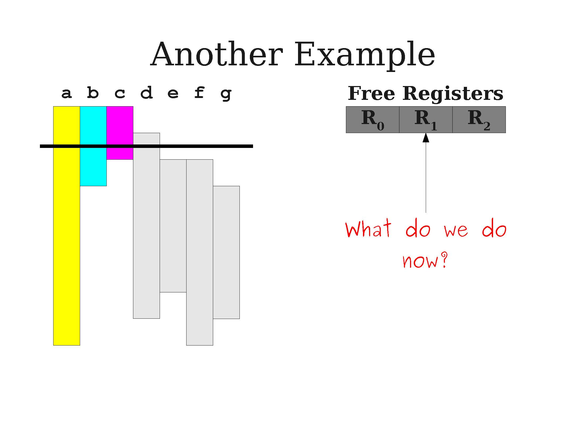
A second demo of greedy allocation
We need a register for d, but we are out of free registers at the moment!
What to do?

Slide 40
Using live ranges
Idea (continued): Given the live intervals for all the variables/IR registers in the TAC program, we can allocate registers using a simple greedy algorithm.
Track which registers are free.
When a live interval begins, give that variable a free register.
When a live interval ends, the register could be freed without consequences.
Works if live variables sets is smaller than number of registers. What to do if not?

Slide 41
Register spilling
Definition (Register Spilling):
If, at a given time, a free register cannot be found for a live variable v, we will need to spill a variable. When a variable is spilled, it is stored in a secondary/less efficient memory location rather than a register.
When we need a register for the spilled variable:
Evict some existing register to a secondary memory location.
Load the variable into the register.
When done, write the register back to memory and reload the register with its original value.
Spilling is slow, but sometimes necessary.

Slide 42
A second demo of greedy allocation
We need a register for d, but we are out of free registers at the moment!
What to do?

Slide 43
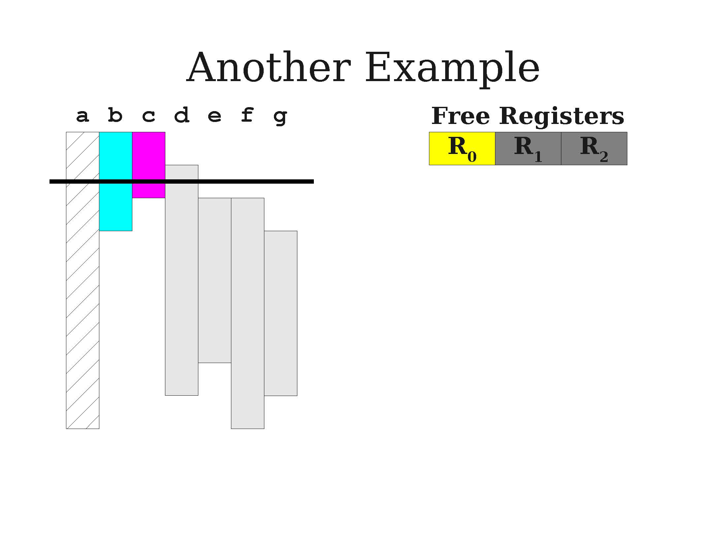
A second demo of greedy allocation
We need a register for d, but we are out of free registers at the moment!
What to do?
Spill variable a for now. Give R1 to d

Slide 44
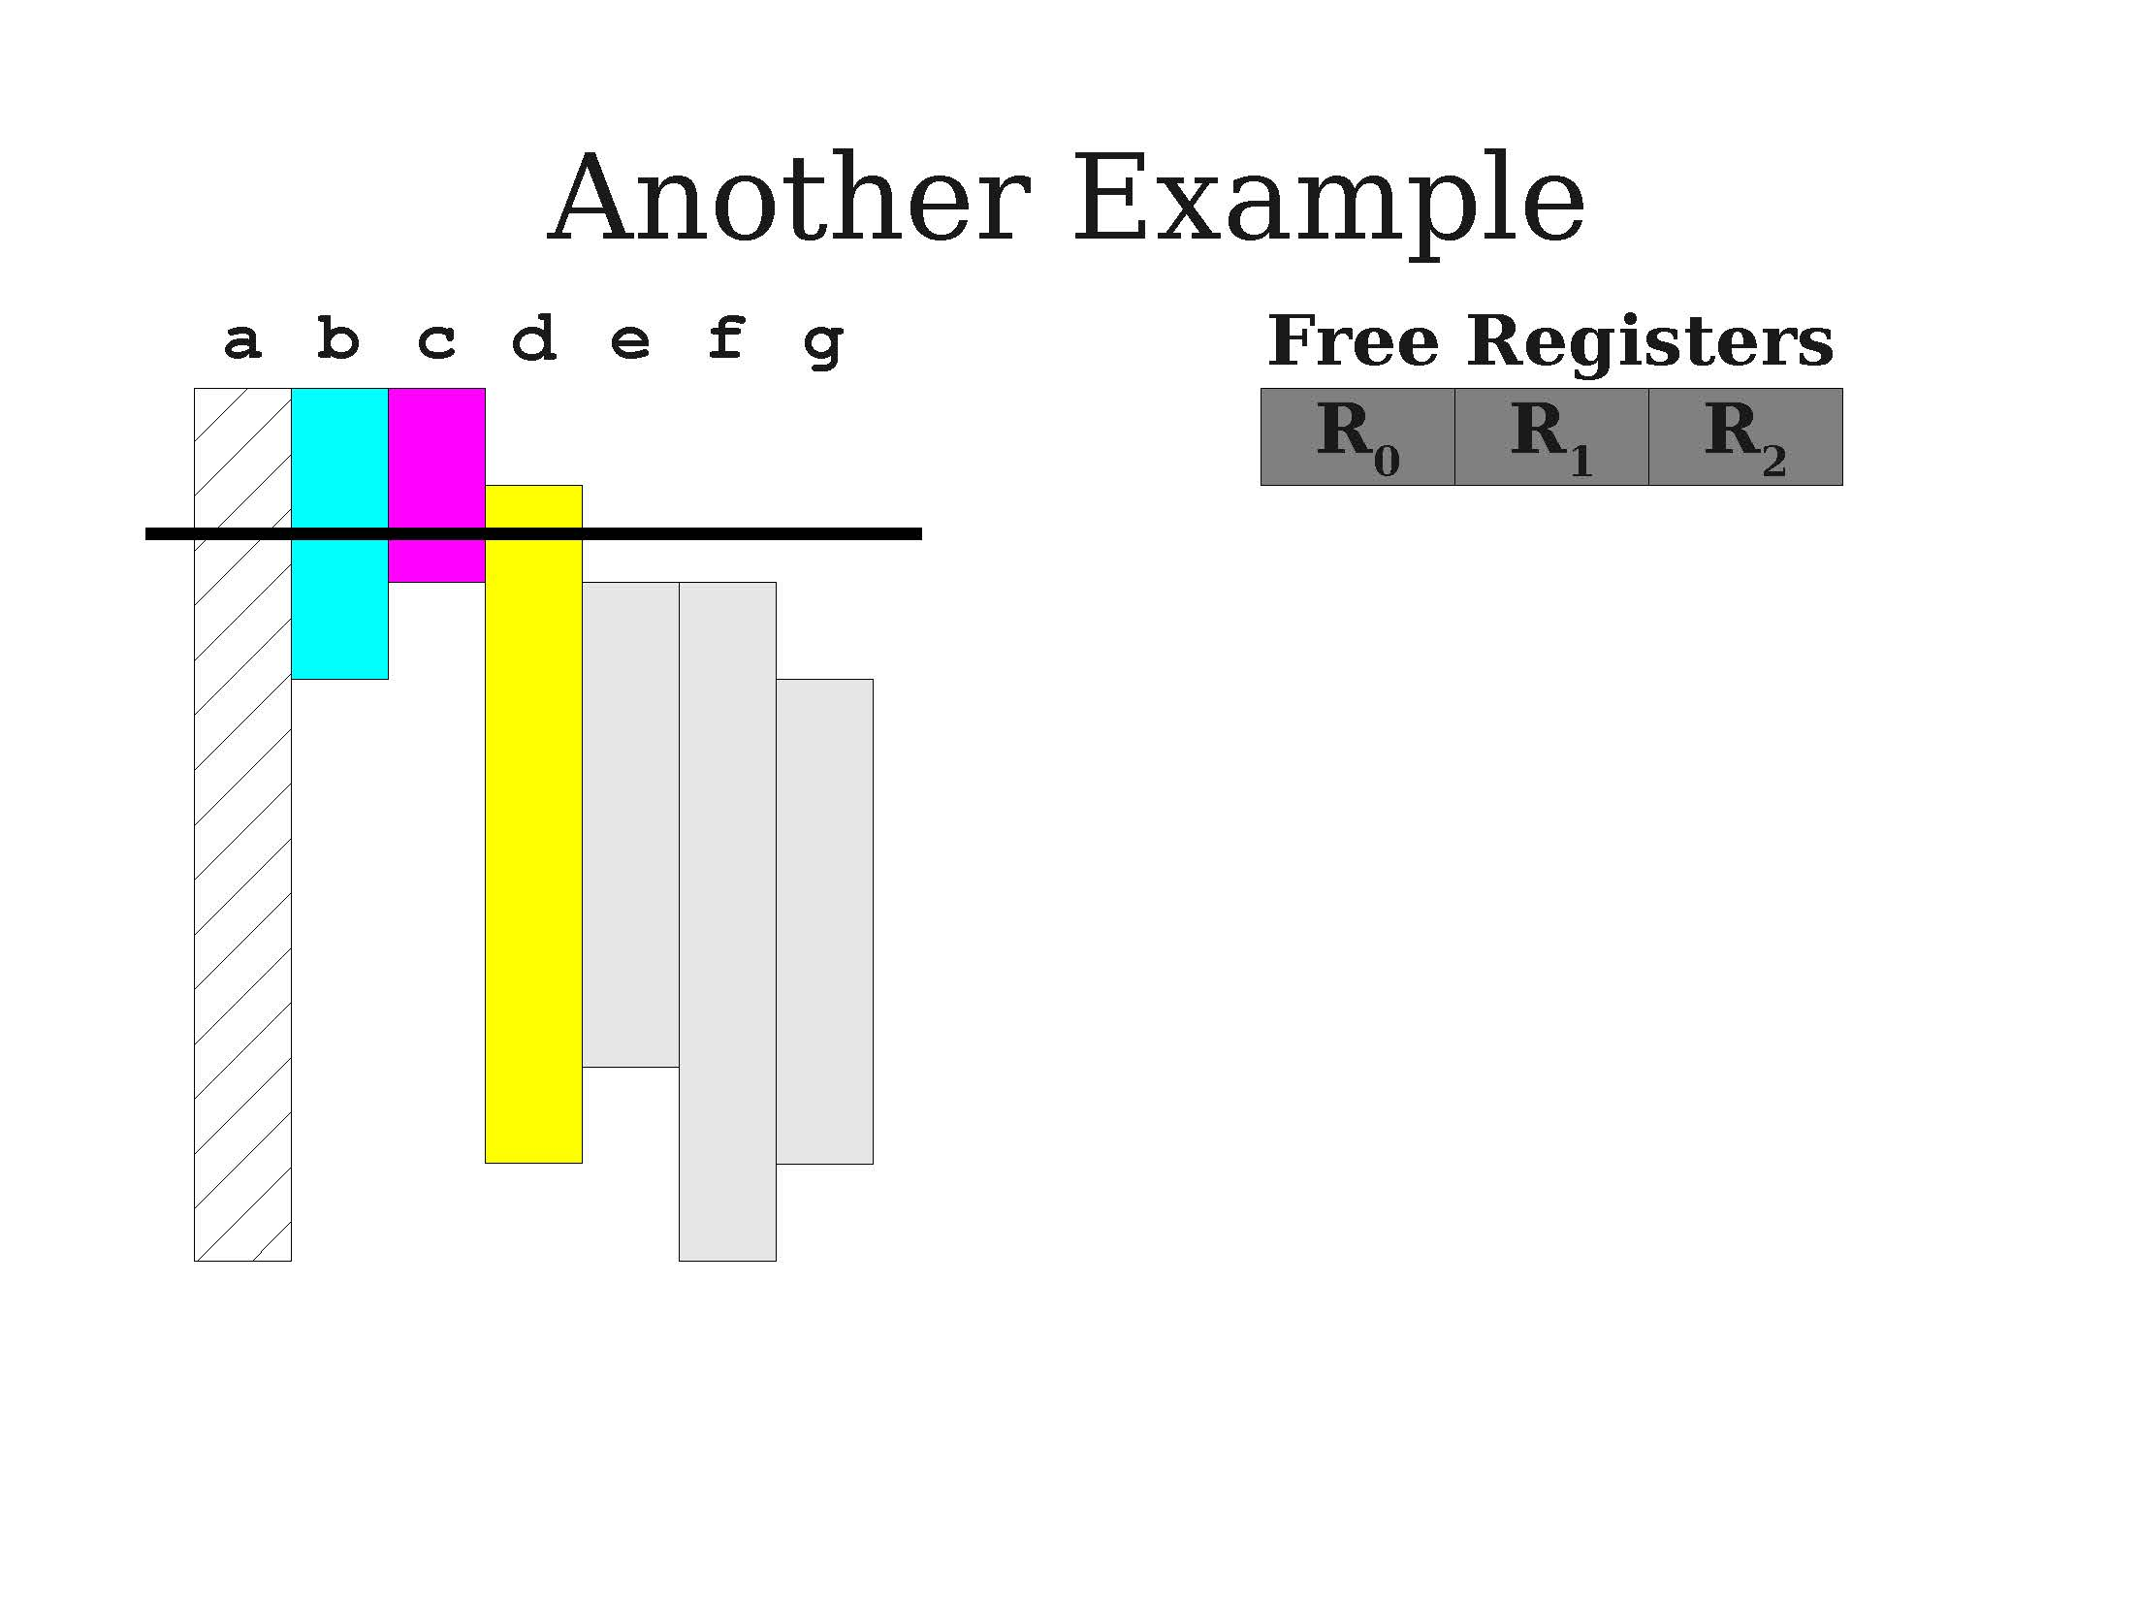
A second demo of greedy allocation
We need a register for d, but we are out of free registers at the moment!
What to do?
Spill variable a for now. Give R1 to d

Slide 45
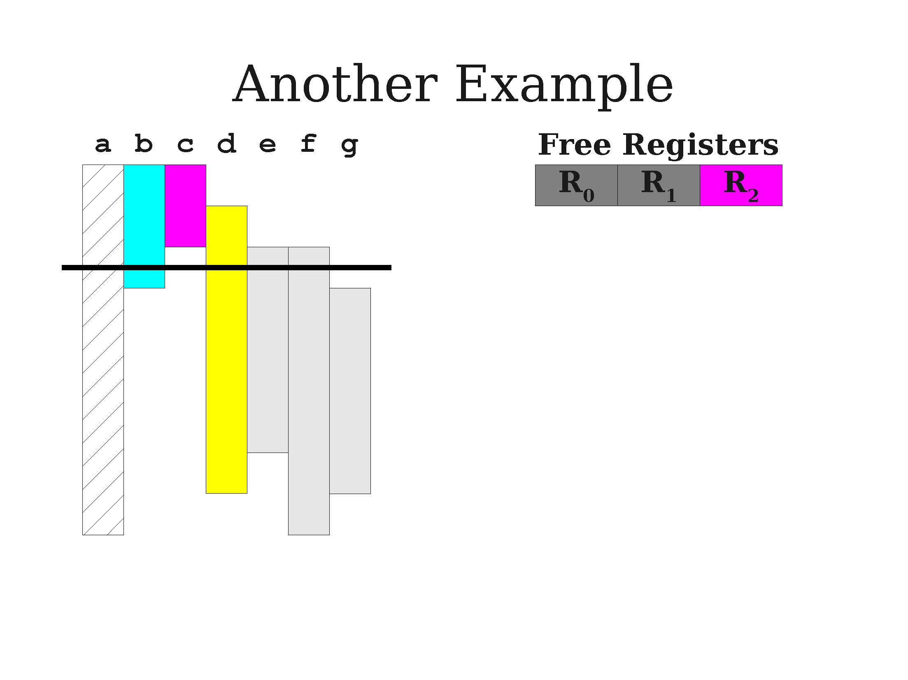
A second demo of greedy allocation

Slide 46
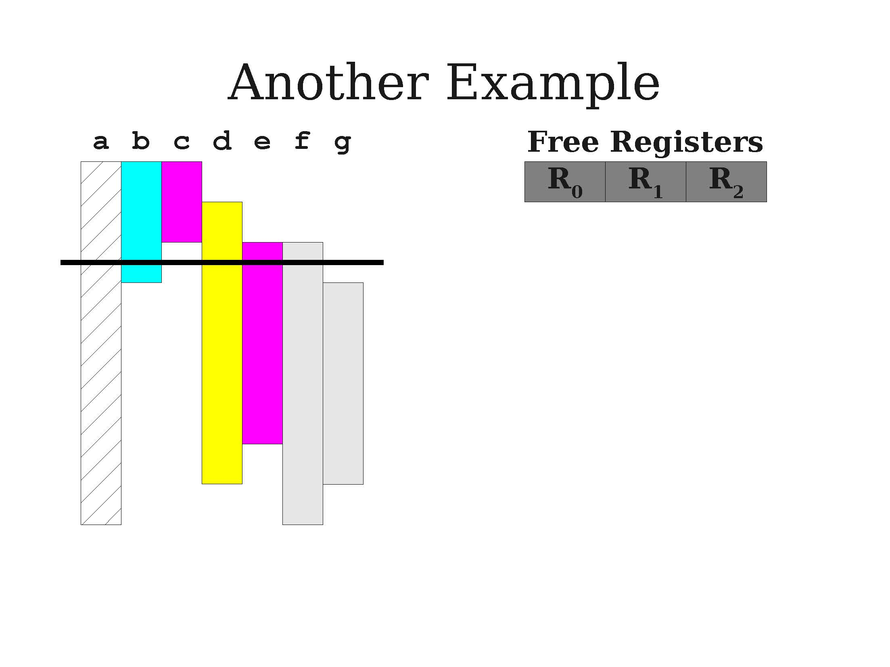
A second demo of greedy allocation

Slide 47
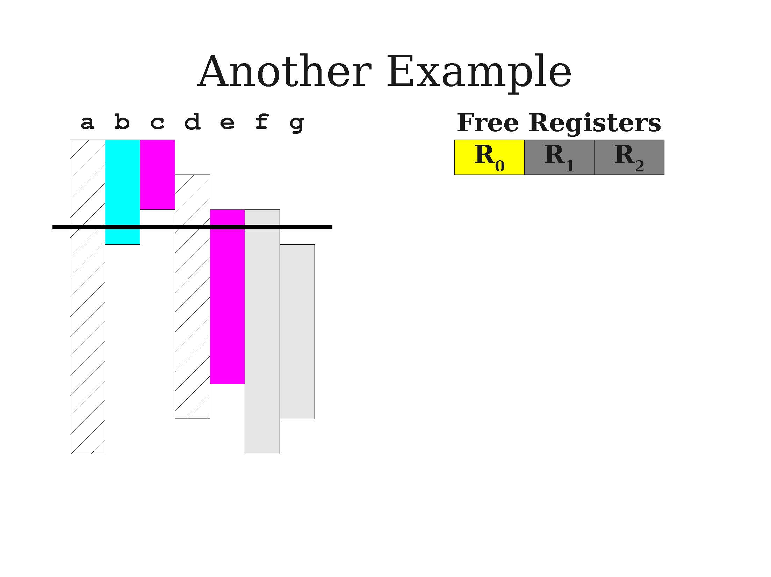
A second demo of greedy allocation

Slide 48
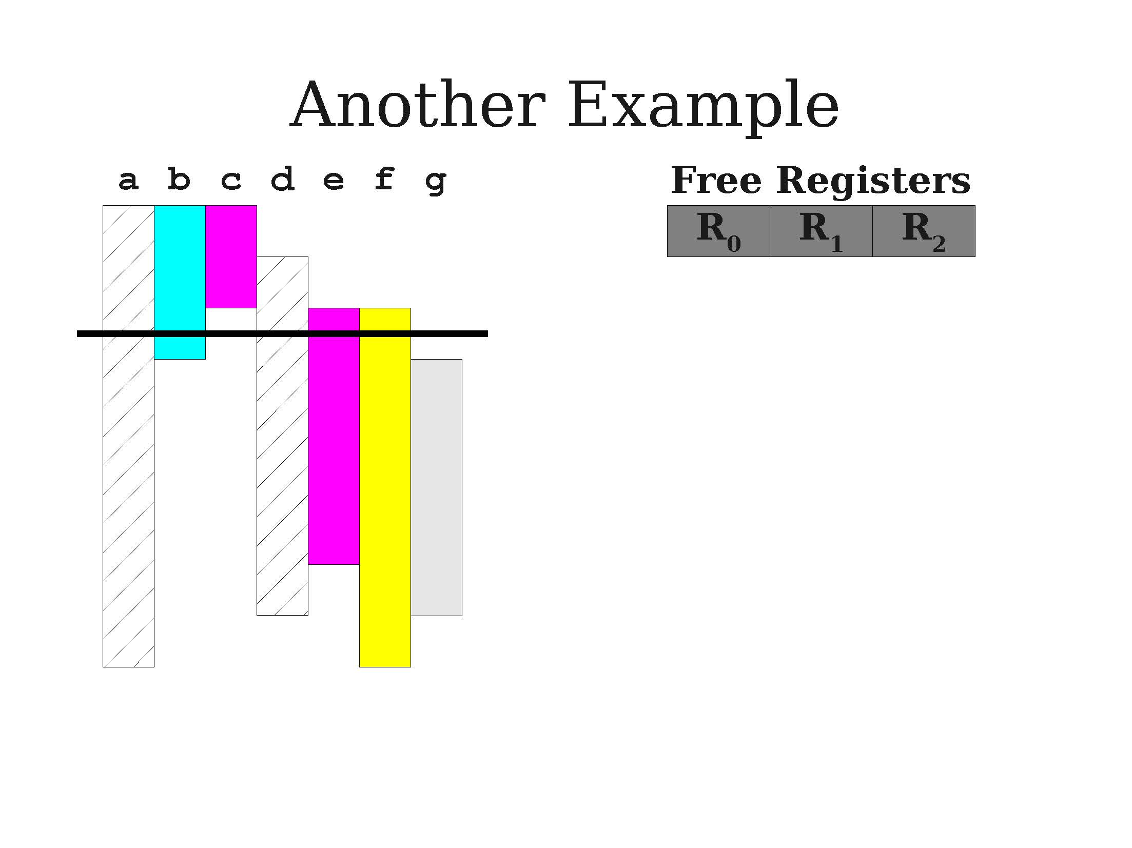
A second demo of greedy allocation

Slide 49
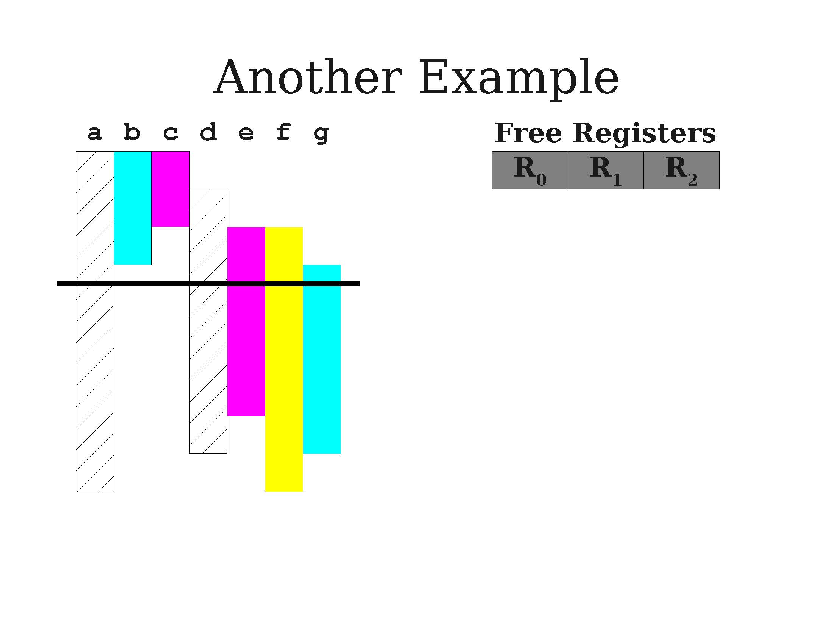
A second demo of greedy allocation

Slide 50
Linear scan register allocation
This greedy algorithm with register spilling is called the linear scan register allocation algorithm.
Advantages:
Very efficient (after computing live intervals, runs in linear time)
Produces good code in many instances.
Allocation step works in one pass; can generate code during iteration.
Disadvantages:
Imprecise due to use of live intervals rather than live ranges.
Other techniques known to be superior in many cases.

Slide 51
Linear scan register allocation
This greedy algorithm with register spilling is called the linear scan register allocation algorithm.
More advanced versions of this algorithm exist, for instance the linear scan register allocation with second-chance bin packing algorithm.
If a variable must be spilled, do not spill all uses of it.
A later live range might still fit into a register.
Requires a final data-flow analysis to confirm variables are assigned consistent locations.

Slide 52
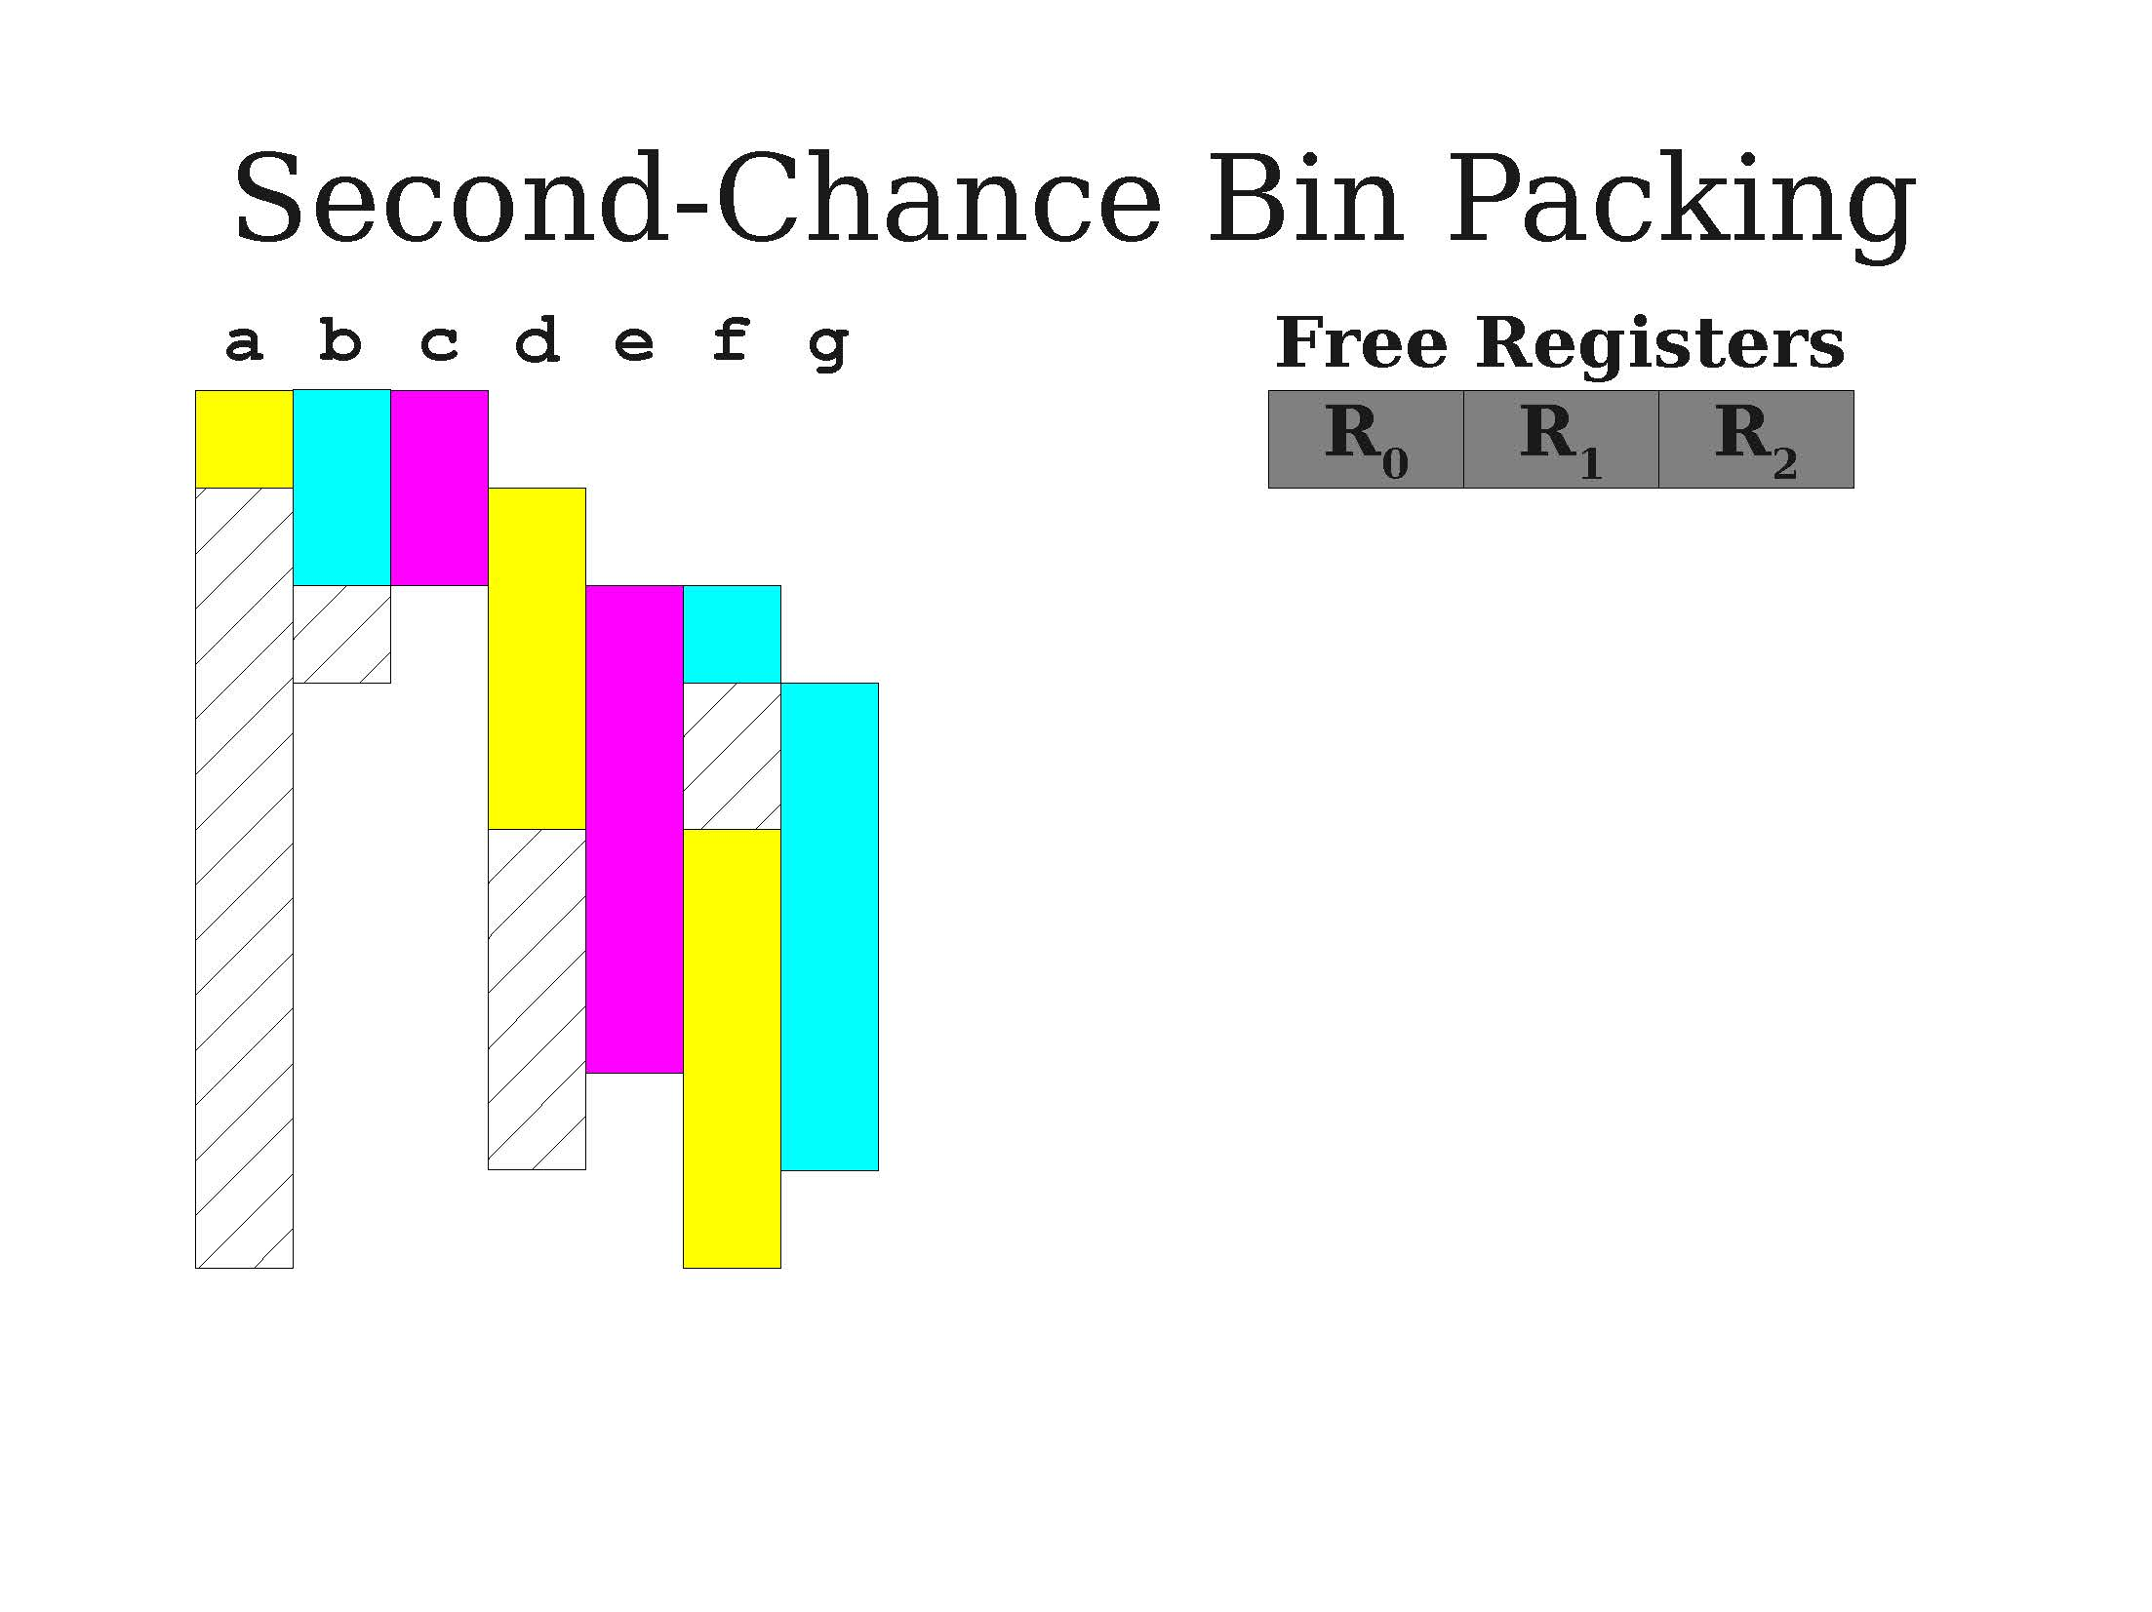
A visual idea for second-chance bin packing
A more advanced greedy allocation

Slide 53
Live interval dependency graph
Definition (Live Interval Dependency Graph):
The more advanced resource allocation algorithms require to understand which variables might happen to be live at the same time.
Represent these dependencies using a graph, where:
Nodes are variables,
Edges describe if two variables will have to be live at the same time at a given point of the program.
This defines a live interval dependency graph for live variables. Also sometimes called register interference graph.

Slide 54
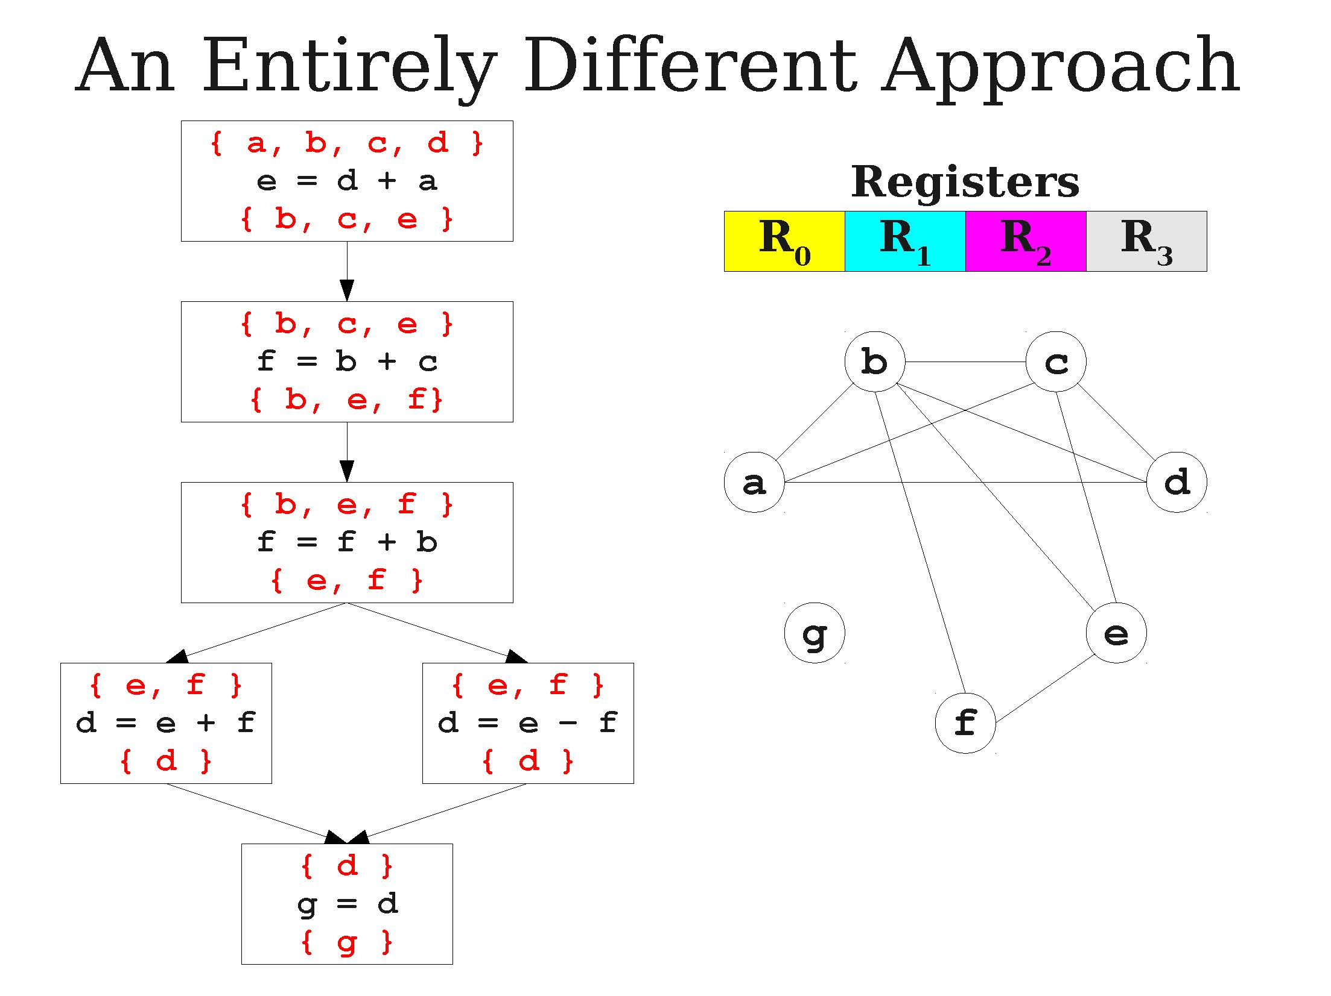
A live dependency graph example

Slide 55
Resolving assignments via the graph
Idea: If we know which variables are supposed to be live together at any given point, then
We can decide, optimally, on the minimum number of memory locations required at any given time to store live variables.
We can decide which memory location to assign to any given variable.
All we need is to assign registers to variables
And make sure no two variables connected by an edge in our live dependency graph are assigned to the same memory location!

Slide 56
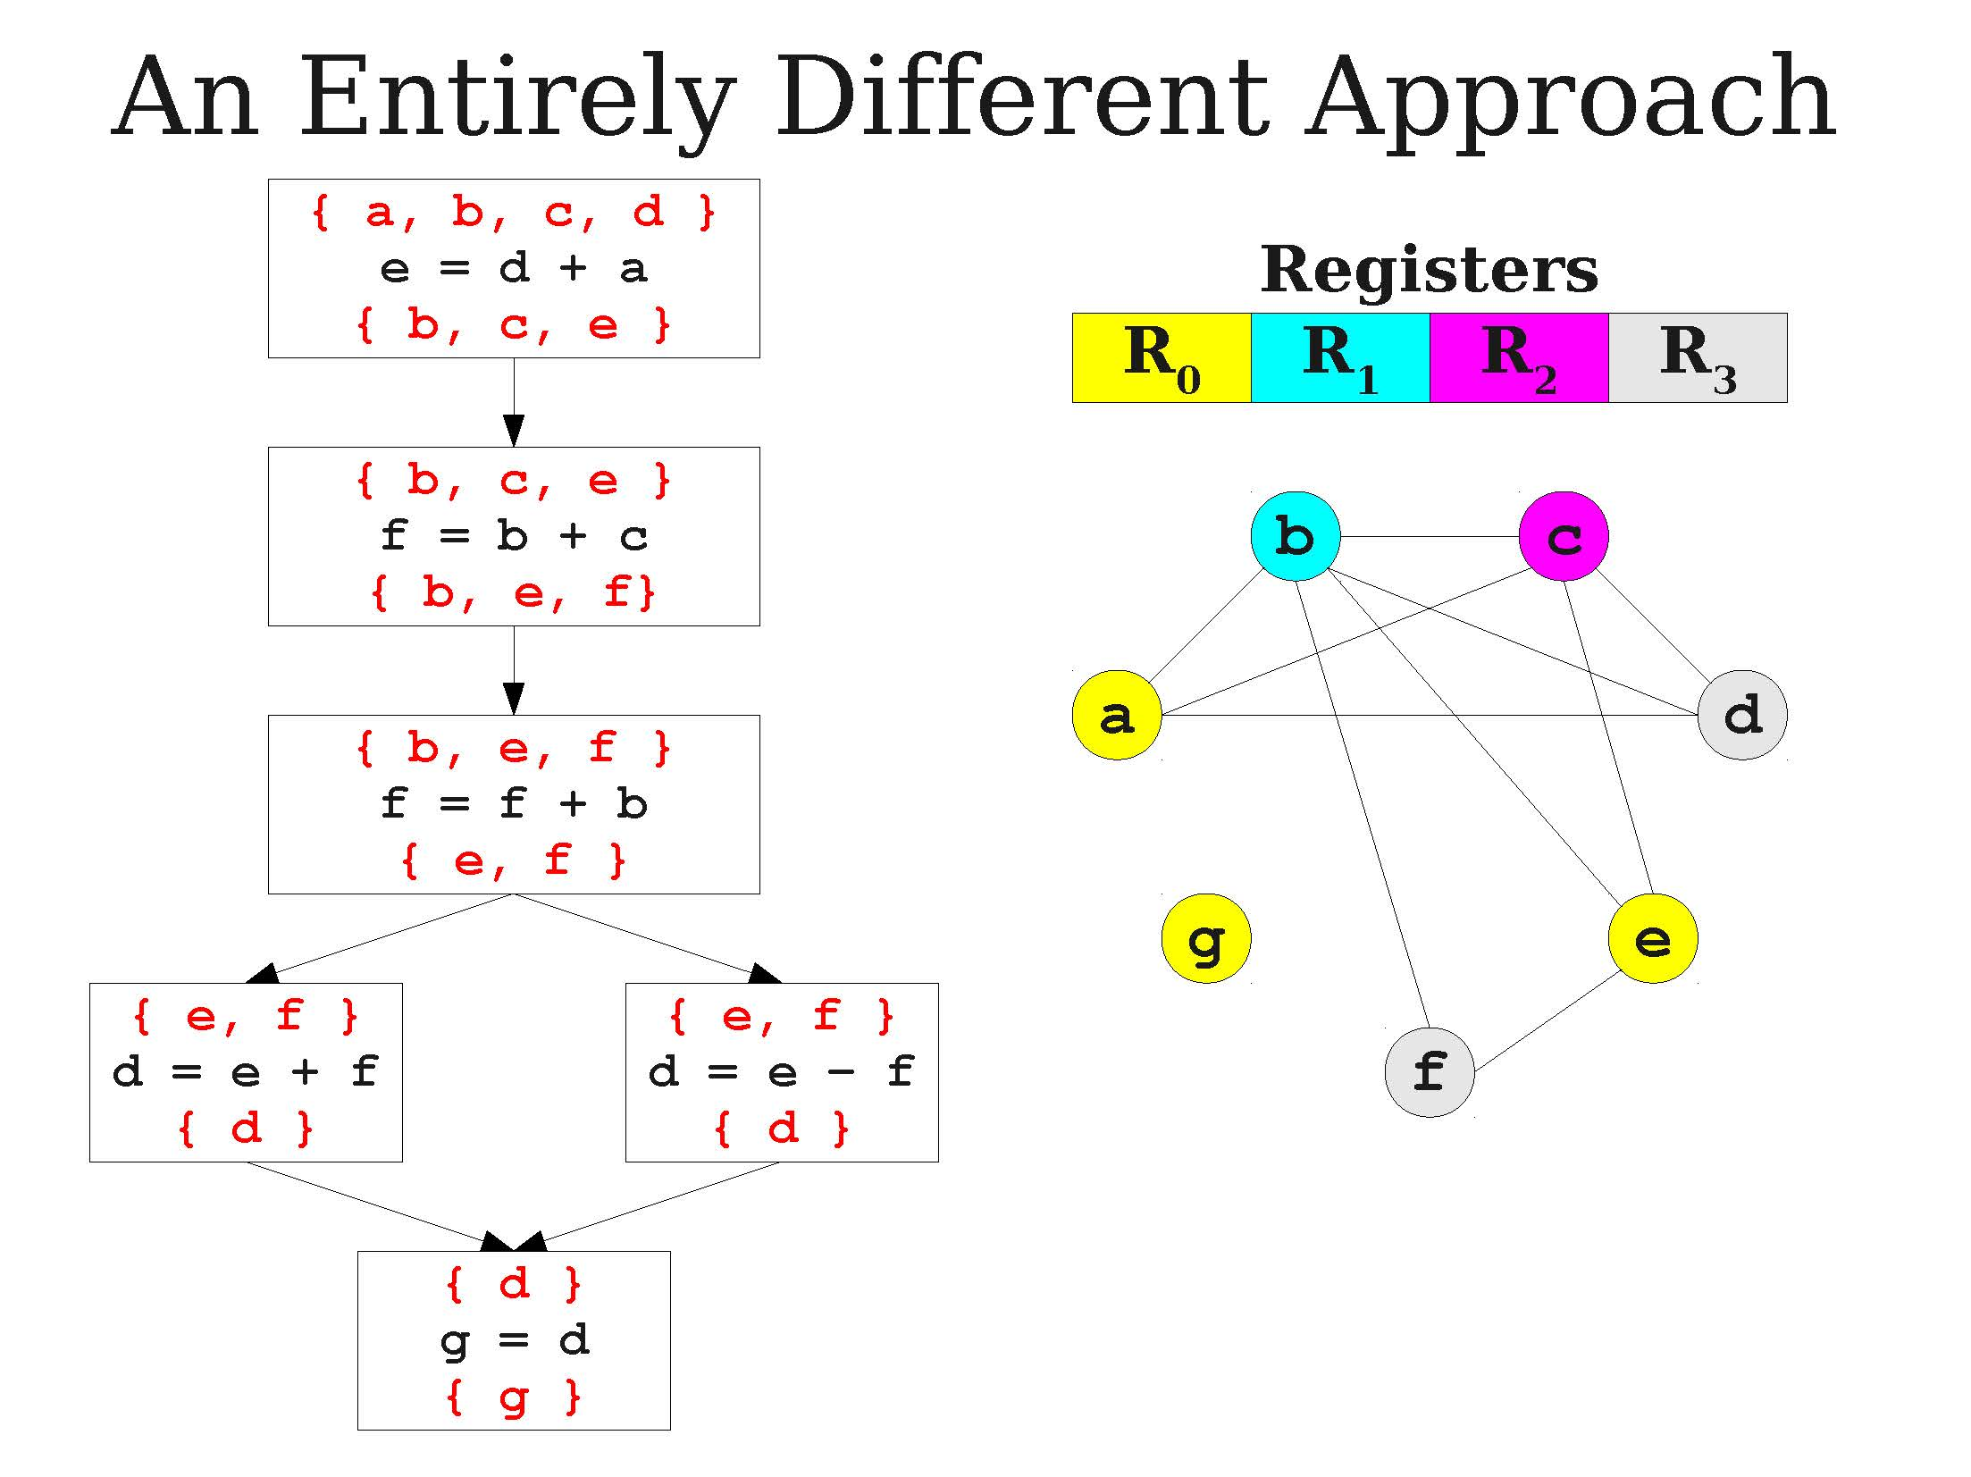
A live dependency graph example

Slide 57
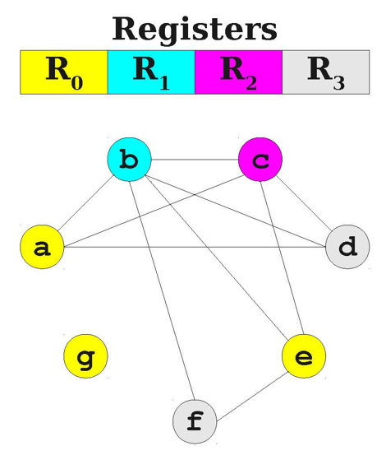
Graph coloring problem
Definition (graph coloring problem):
This problem is a well-known problem in graph theory, called the graph coloring problem.
Typically, try to colorize each node, with no two nodes with the same color connected via an edge.
Small problem, it is NP-hard (again!).
Some heuristics exist (e.g. Chaitin’s algorithm), but still pretty much an open problem in graph theory! (out-of-scope)

Slide 58
Possible algorithms to investigate
Lesson: The register allocation problem, like many other problems in compilers, is not an easy one to solve! (NP-hard).
Naïve (“no”) register allocation.
Linear scan register allocation.
Graph-coloring register allocation.
In addition: Advanced versions of these algorithms might need to discuss with the processor and the OS as to what resources are available (e.g. other programs running, multi-core CPUs, parallelised computing, number of registers, GPU computing, etc.).
These are, again, too advanced and out-of-scope.

Slide 59
Quiz time!
What is the main purpose of translating three-address code to assembly code?
To create an executable binary
To optimize the code to its maximal level
To make the code human-readable
To simplify the code and ensure it runs fast

Slide 60
Quiz time!
What is the main purpose of translating three-address code to assembly code?
To create an executable binary
To optimize the code to its maximal level
To make the code human-readable
To simplify the code and ensure it runs fast

Slide 61
Quiz time!
Which of the following is NOT a characteristic of assembly code?
It is a low-level programming language
It is human-readable
It contains variables and loops
It is specific to a particular computer architecture

Slide 62
Quiz time!
Which of the following is NOT a characteristic of assembly code?
It is a low-level programming language
It is human-readable
It contains variables and loops
It is specific to a particular computer architecture

Slide 63
Quiz time!
In the context of memory hierarchy, which of the following memory types has the fastest access time?
Registers
SRAM
DRAM
SSD drive

Slide 64
Quiz time!
In the context of memory hierarchy, which of the following memory types has the fastest access time?
Registers
SRAM
DRAM
SSD drive

Slide 65
Quiz time!
What is the primary goal of register allocation in a compiler?
To improve code readability
To reduce the number of registers required
To minimize the number of memory accesses
To ensure no memory information is lost upon computer shutdown

Slide 66
Quiz time!
What is the primary goal of register allocation in a compiler?
To improve code readability
To reduce the number of registers required
To minimize the number of memory accesses
To ensure no memory information is lost upon computer shutdown

Slide 67
Quiz time!
Which register allocation strategy attempts to minimize the number of registers needed for a specific computation?
Graph coloring algorithms
Linear scan algorithm
Naive algorithm
Greedy algorithm

Slide 68
Quiz time!
Which register allocation strategy attempts to minimize the number of registers needed for a specific computation?
Graph coloring algorithms
Linear scan algorithm
Naive algorithm
Greedy algorithm

Slide 69
What we have seen this term
About compilers

Slide 70
Compiler: a definition
Program in a given language (source language)
Definition (Compilers): Compilers are computer programs whose purpose is to
Translate a program written in one language (called source language),
Into a program written in another language (called target language).
Target language is often machine code or bytecode.
Compiler
Program in another language
(target language, often machine code, or bytecode)

Slide 71
The architecture of a compiler
Definition (the three parts of a typical compiler architecture):
A typical compiler architecture consists of three main components: the front-end, middle-end, and back-end.
Front-end: checks source code is legal (90% of the compiler job!).
Middle-end (optional?): IR code generation and optimization.
Back-end: Final translation and handover to CPU!

Slide 72
How to continue your learning
Because you should!

Slide 73
Continue your learning
W4-5: FSMs and their implementation
Continue with more advanced types of FSMs (non-deterministic, push automatons, etc.).
Learn how to convert any NDFSM into its equivalent FSM (tedious, but possible all the time).
Good online courses:
MIT Theory of Computation
Stanford Automata Theory

Slide 74
Continue your learning
W4-5: RegEx and their implementation
Not much else in terms of implementing FSMs and RegEx.
Maybe try making your own RegEx engine that takes any RegEx expression (basic operations only) and generates the correct FSM.
Then use said FSM to check validity of a given string.
Learn to recognize the RegEx behind any given FSM.
Good online courses:
Few good courses will teach you about implementation in C…
Maybe this one?

Slide 75
Continue your learning
W8: Tokenization
Not much else on this topic.
Possible improvement #1: We generate/compile the RegEx FSM every time we call said RegEx function. Would be better to only generate it once?
How to handle the C pre-processing instructions before tokenization?

Slide 76
Continue your learning
W9: CFGs
How to implement a full CFG engine?
For a given set of production rules to use, write an algorithm that would build the parse tree matching a given derivation.
Good online courses:
Very few, most of the time, better to check Github for implementations.
Maybe this? (not C)

Slide 77
Continue your learning
W10: SDTs
How to implement an SDT, and following the idea of the parse tree generating algorithm, how would you build an abstract syntax tree?
Good online courses:
As with CFGs, very few courses online, most of the time, better to check Github for implementations.

Slide 78
Continue your learning
W10: Parsing
Try implementing LR(0) and LR(1) algorithms as in Lab 6!
Learn about more advanced classes of LR parsers like SLR and LALR.
Good course:
SUTD Term 7 course? 50.054 Compiler Design and Program Analysis, by Prof. Kenny Lu (in the case of functional programming).

Slide 79
Continue your learning
W11: Semantics
Try implementing a symbol table, as a simple stack, or better, a spaghetti stack! Later on, implement your own scope checking for the semantics analysis.
Try implementing your own type checking rules and operation tables. Later on, implement your own type checking for the semantics analysis.
Good online courses:
As with CFGs/SDTs, very few courses online, most of the time, better to check Github for implementations.

Slide 80
Continue your learning
W11: TAC code generation
Write your own CFG and SDT for the TAC language.
Write your own translator function that reads an AST and produces the TAC accordingly.
Work out more cgen() functions for while loops, for loops, break, functions calls, class definitions and methods, etc.
Good online courses:
As with CFGs/SDTs, very few courses online, most of the time, better to check Github for implementations.

Slide 81
Continue your learning
W12: TAC code optimization
Try implementing the Copy Propagation optimization procedure.
Try implementing a liveness analysis (challenging!).
Try implementing a Dead Code Elimination optimization procedure.
Chain them, rinse and repeat local optimization function for all basic blocks in your code!
Try implementing more local optimization techniques (arithmetic simplifications, short-circuit evaluation, constant folding, etc.)
Eventually, try writing a control-flow graph representation for your TAC code and study/implement more advanced (global) optimization procedures.

Slide 82
Continue your learning
W12: Backend
Try writing a simple translator that reads TAC code (either as a string of text of a control-flow graph), and produces assembly code (following the Beta CPU instruction set from 50.002).
Try implementing a few register allocation algorithm (naïve, linear scan, etc.)
Try your hands on the graph coloring problem and the Chaitin algorithm implementation!
More backend stuff (runtime, garbage collection, code optimization and clock cycles optimization on your CPU by performing instruction ordering/section, parallelism, etc.)

Slide 83
And interpreters in all of this?
Definition (Interpreters):
Many of you have probably heard about the compilers vs. interpreters paradigm, but what is it about?
Interpreters have the same objective as compilers, i.e. translate a source program into target code which can be executed by the CPU.
What changes is the translation and execution procedure:
Compilers will translate the source code into target code in its entirety first, and THEN will execute the target code.
Interpreters, on the other hand, will translate each line of the source code one line at a time, and execute each one of them in succession.

Slide 84
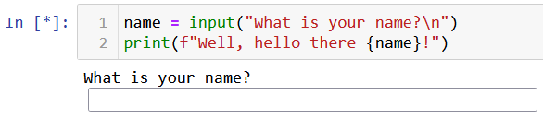
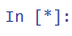
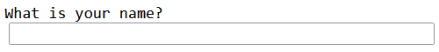
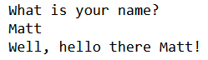
Source Program (Python)
Interpreter
…
Line 1
Line 2
Line N
Source Program (Python)
Source Program (Python)
Translate, check for errors, etc. and execute
Translate, check for errors, etc. and execute
…
Results
Results
Results

Slide 85
Reference courses, in short
If interested to learn more about parsers, the reference course is the Compiler course from Stanford
https://web.stanford.edu/class/cs143/
Available for free online and comes with video recordings
https://www.edx.org/course/compilers
SUTD Term 7 course? 50.054 Compiler Design and Program Analysis, by Prof. Kenny Lu (in the case of functional programming).
(Not yet added to ISTD course catalog as of 20/04/2023.)
(Tentative syllabus to be shown in class!)

Slide 86
Your feedback matters!
It is our third time trying this course, and as instructors, we learned a lot by trying it, but also realized a few things did not work out…
Typically, 6 weeks might be a bit too short to teach all the concepts of compilers correctly (maybe we should shorten the C/C++ part to make room for compilers?).
A lab session or two to have you implement some semantics checks, in a guided manner, would have been nice.
Will improve for next run.
Let us know if you have more feedback for us!

Slide 87

The End
Also, remember: if the code is legal according to the compiler but does not produce the behavior you expect, then it is not the compiler’s fault…The problem is…

Slide 88
The End
Also, remember: if the code is legal according to the compiler but does not produce the behavior you expect, then it is not the compiler’s fault…The problem is… You!
It is not the compiler’s job to figure out the logic you want your code to have!
And debug it for you if it fails!
(How would the compiler do it anyway?)

